Slide 1
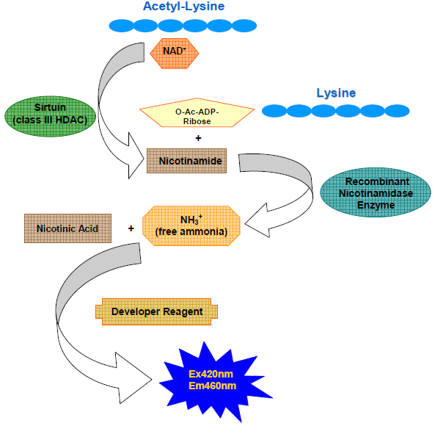
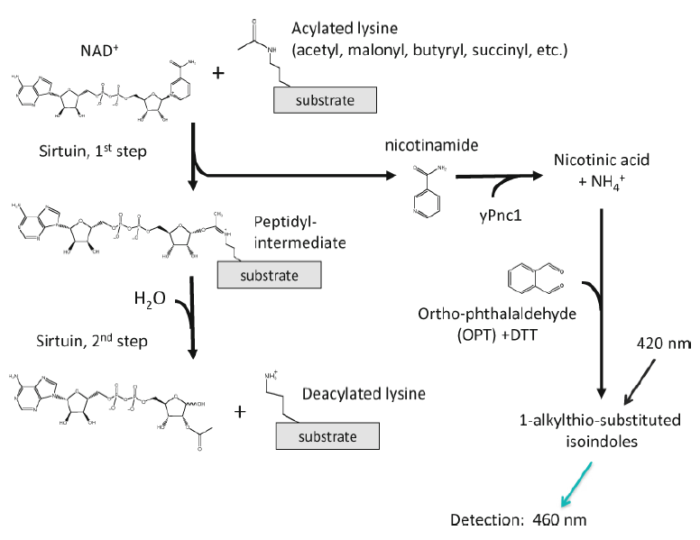
SIRTainty™ Class III HDAC Assay - Mechanism
Step I: NAM formation, then nicotinamidase converts NAM into free amino and nicotinic acid.
Step II: To generate a signal for readout, a proprietary developer reagent is added and the signal is read using a fluorescent plate reader.
(Chemistry behind is :The obtained ammonia is then quntized by reacting with ortho-phathalaldehyde (OPT) and dithiothreitol (DTT), with the formation of 1-alkylthioisoindoles detected at 460nnm.)

Slide 2
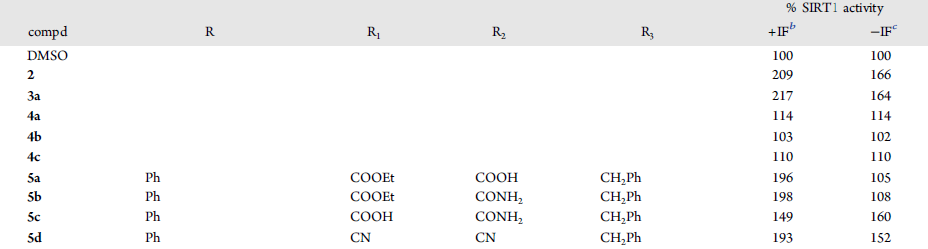
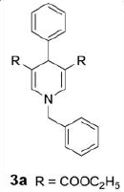
Reported SIRT1 activation by DHP1c Results-II
Sergio Valente et. al. 1,4-Dihydropyridines Active on the SIRT1/AMPK Pathway Ameliorate Skin Repair and Mitochondrial Function and Exhibit Inhibition of Proliferation in Cancer Cells (2015) J. Med. Chem. xx, xxxx.
In the SIRTainty assay, 50uM of compound 3a (DHP1c) provide 217% (with intrinsic fluorescence) and 164% (after intrinsic fluorescence subtraction) SIRT1 activity.

Slide 3
Repeat JMC 2015 experiment in PMC-AT Lab
Experimental conditions
[SIRT1] =5U/reaction
[NAD⁺] =200 μM
[H3K9 peptide] =25 μM
[DHP1c] = 50uM
% DMSO= 2%
Time points= 0, 30 min
Temp.= 37oC
Gain (TeCan )=65
Operation procedure
The deacetylation reaction was initiated by addition of SIRT1 enzyme. The mix was incubated at 37oC for 30min. Developer was added upon the desired time point and incubated at room temperature for 30min avoiding light. Then read the sample on TeCan at Ex/Em=420nm/460nm.
 | Run 1 |  | Run 2 |  | Avg_0min | Avg_60min | Δ AFU | % Activity
 | 0 min | 60 min | 0 min | 60 min
Buffer only (no SIRT1) | 247 | 166 | 161 | 153 | 204.0 | 159.5
Negative control (NAD+ peptide substrate+PNCA1+Assay buffer-no SIRT1) | 342 | 305 | 280 | 303 | 311.0 | 304.0
Positive control (NAD+ peptide substrate+PNCA1+Assay buffer+ SIRT1) | 277 | 417 | 297 | 408 | 287.0 | 412.5 | 125.5
2% DMSO (NAD+ peptide substrate+PNCA1+Assay buffer + DMSO-no SIRT1) | 315 | 233 | 275 | 253 | 295.0 | 243.0
2% DMSO (NAD+ peptide substrate+PNCA1+Assay buffer+DMSO+SIRT1) | 276 | 347 | 250 | 312 | 263.0 | 329.5 | 66.5 | 100.0
DHP1c (NAD+ peptide substrate+PNCA1+Assay buffer+DHP1c-no SIRT1) | 1149 | 1105 | 1221 | 1099 | 1185.0 | 1102.0
DHP1c (NAD+ peptide substrate+PNCA1+Assay buffer+DHP1c + SIRT1) | 1153 | 1234 | 1042 | 1212 | 1097.5 | 1223.0 | 125.5 | 188.7
Calculation details (Method A) : ΔAFU = AFU _{60min} – AFU _{0min}

Slide 4
Repeat JMC 2015 experiment in PMC-AT Lab
Experimental conditions
[SIRT1] =5U/reaction
[NAD⁺] =200 μM
[H3K9 peptide] =25 μM
[DHP1c] = 50uM
% DMSO= 2%
Time points= 0, 30 min
Temp.= 37oC
Gain (TeCan )=65
Operation procedure
The deacetylation reaction was initiated by addition of SIRT1 enzyme. The mix was incubated at 37oC for 30min. Developer was added upon the desired time point and incubated at room temperature for 30min avoiding light. Then read the sample on TeCan at Ex/Em=420nm/460nm.
 | Run 1 |  | Run 2 |  | Avg_0min | Avg_60min | Background Subtraction |  | Δ AFU | % Activity
 | 0 min | 60 min | 0 min | 60 min |  |  | ΔAFU_0min | ΔAFU_60min
Buffer only (no SIRT1) | 247 | 166 | 161 | 153 | 204.0 | 159.5
Negative control (NAD+ peptide substrate+PNCA1+Assay buffer-no SIRT1) | 342 | 305 | 280 | 303 | 311.0 | 304.0
Positive control (NAD+ peptide substrate+PNCA1+Assay buffer+ SIRT1) | 277 | 417 | 297 | 408 | 287.0 | 412.5 | -24.0 | 108.5 | 132.5
2% DMSO (NAD+ peptide substrate+PNCA1+Assay buffer + DMSO-no SIRT1) | 315 | 233 | 275 | 253 | 295.0 | 243.0
2% DMSO (NAD+ peptide substrate+PNCA1+Assay buffer+DMSO+SIRT1) | 276 | 347 | 250 | 312 | 263.0 | 329.5 | -32.0 | 86.5 | 118.5 | 100
DHP1c (NAD+ peptide substrate+PNCA1+Assay buffer+DHP1c-no SIRT1) | 1149 | 1105 | 1221 | 1099 | 1185.0 | 1102.0
DHP1c (NAD+ peptide substrate+PNCA1+Assay buffer+DHP1c + SIRT1) | 1153 | 1234 | 1042 | 1212 | 1097.5 | 1223.0 | -87.5 | 121.0 | 208.5 | 175.9
Calculation details (Method B) :
  ΔAFU = ΔAFU_60min – ΔAFU_0min
  ΔAFU_0min = AFU(with SIRT1) – AFU(without SIRT1) at 0min time point
  ΔAFU_60min =AFU(with SIRT1) – AFU(without SIRT1) at 60min time point

Slide 5
SIRTainty Reading Stability Test
To check if the reading is stable and for how long, the data start taking right after 30 min incubation with developer., which is 0min time point. Then more reading was taken in every 10 min. Interesting to see
% activity calculated using method A, keep roughly same
% activity calculated using method B decreased as increasing the time.
This is very critical in terms of how to choose the right time to read the data.
Method A
Method B

Slide 6
SIRTainty Reading Stability Test Cont’d
However, looking at positive control ΔAFU, the number constantly increasing as increasing time. This is indicated that
SIRTainty assay has no quenching reagent to stop the reaction.
It is possible to study kinetic reaction (initial rate etc) using the same reaction but taking different readings at different time point. This will
  Eliminate the error from using different reaction for different time point!!!
  Save a lot of reagent!!!
Method A
Method B

Slide 7
SIRTainty™ Class III HDAC Assay – Highlight
SIRT1 activation was detected by addition of 50uM DHP1c under current conditions (Exact JMC 2015 conditions).
Method for % Activity calculation are important.
SIRTainty assay can be used for initial rate study.
Next Step
The reactions solutions from SIRTainty have been collected and frozen into -80oC.
HPLC method need to be applied to validate the DHP1c/SIRT1 SIRTainty results.
  Run samples collected from SIRTainty reaction
  Prepare reactions under the same conditions for the first step. Read the finished reaction sample without adding developer.
If the activation have been spotted, it may suggested DHP1c is a substrate specific SIRT1 activator.
we will move to test DHP1c/SIRT3 using H3K14 peptide (available in lab) using SIRTainty assay.

