Slide 1
Comparison of deacetylation efficiency between AceCS2 and p53 by in-house SIRT3

Slide 2
Experimental conditions
  [In-house SIRT3]=9.5U
  [AceCS2 or p53 peptide]= 50, 600 uM
  [NAD+]=100, 2000 uM
  Temp.= 37 ºC
  Time point = 30 min
Note:
In-house SIRT3
  Batch 3 with activity 0.95U/ul
P53 peptide
  Pep1: NH2-KKGQSTSRHK(KAc)LMFKTEG-COOH
  Pep1c: NH2-KKGQSTSRHKKLMFKTEG-COOH
K⁶⁴²acetylated human acetyl-coenzyme A synthetase 2 (AceCS2)
  Pep3: NH2-TRSG(KAc)VMRRLLR-COOH
  Pep3c: NH2-TRSGKVMRRLLR-COOH

Slide 3
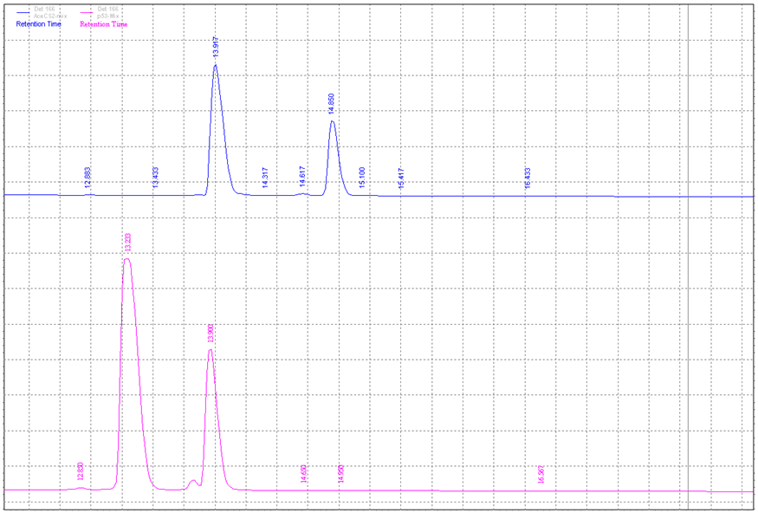
Identify retention time of different acetyl/deacetyl peptides
Deacetyl-AceCS2
Acetyl-AceCS2
Deacetyl-p53
Acetyl-p53

Slide 4
AceCS2 and p53 Deacetylation efficiency by in-house SIRT3- Sub saturating condition
[NAD+] = 100uM [Peptide]= 50uM | p53 |  |  | AceCS2
 | 0 min | 30min | 60min | 0 min | 30min | 60min
Rt_Product, min |  | 13.383 | 13.333 |  | 14.017 | 14.017
Rt_ Acetyl- peptide, min |  | 13.95 | 13.917 | 14.900 | 14.900 | 14.900
ΔRt, min |  | 0.567 | 0.584 |  | 0.883 | 0.883
Peak Are_product |  | 218174 | 495538 |  | 239326 | 359211
Peak Are_Acetyl peptide |  | 1873354 | 1856208 | 1123548 | 869971 | 805077
Total Area |  | 2091528 | 2351746 | 1123548 | 1109297 | 1164288
% Product |  | 10.4 | 21.1 |  | 21.6 | 30.9
pmoles |  | 208.6 | 421.4 |  | 431.5 | 617.0

Slide 5
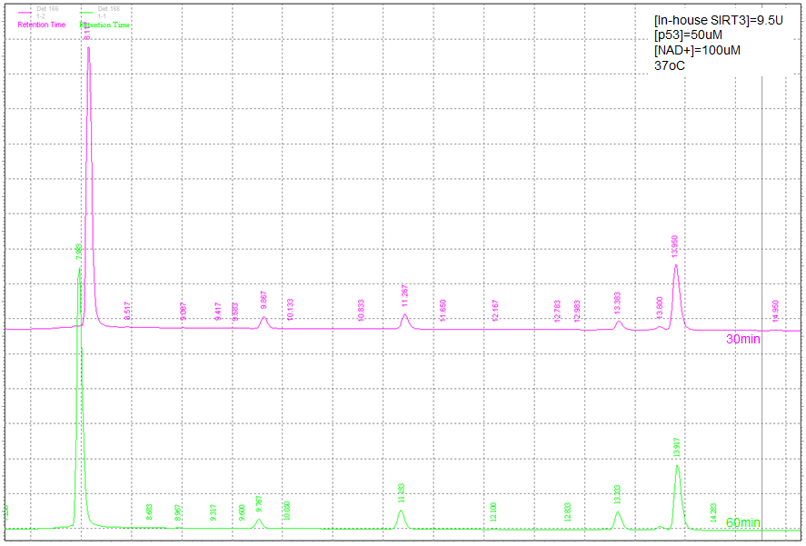
p53

Slide 6
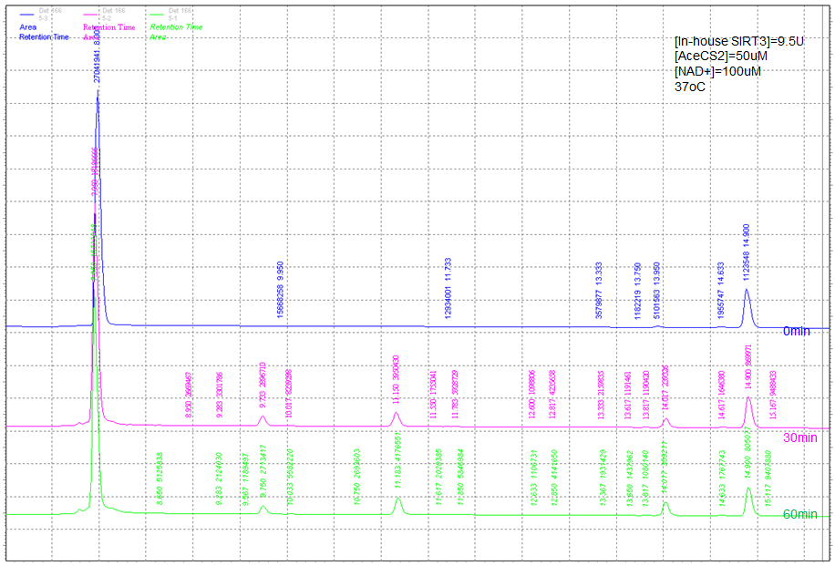
AceCS2

Slide 7
AceCS2 and p53 Deacetylation efficiency by in-house SIRT3- Saturating condition
[NAD+] = 2000uM [Peptide]= 600uM | p53 |  |  | AceCS2
 | 0 min | 30min | 60min | 0 min | 30min | 60min
Rt_Product, min |  | 13.350 | 13.317 |  | 14.017 | 14.017
Rt_ Acetyl- peptide, min | 13.833 | 13.833 | 13.783 | 14.767 | 14.800 | 14.800
ΔRt, min |  | 0.483 | 0.466 |  | 0.783 | 0.783
Peak Are_product |  | 1837706 | 3167191 |  | 1447055 | 1831106
Peak Are_Acetyl peptide | 22146987 | 20348934 | 19679357 | 12108531 | 10943774 | 10683000
Total Area | 22146987 | 22186640 | 22846548 | 12108531 | 12390829 | 12514106
% Product |  | 8.3 | 13.9 |  | 11.7 | 14.6
pmoles |  | 1987.9 | 3327.1 |  | 2802.8 | 3511.8

Slide 8
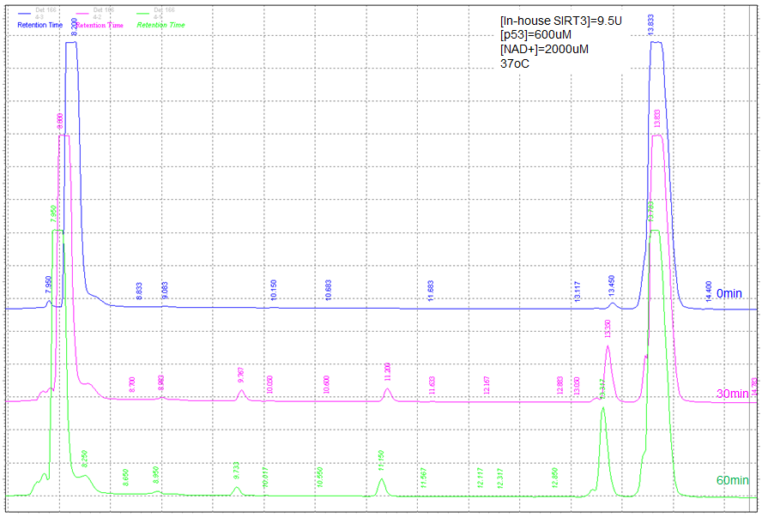
p53

Slide 9
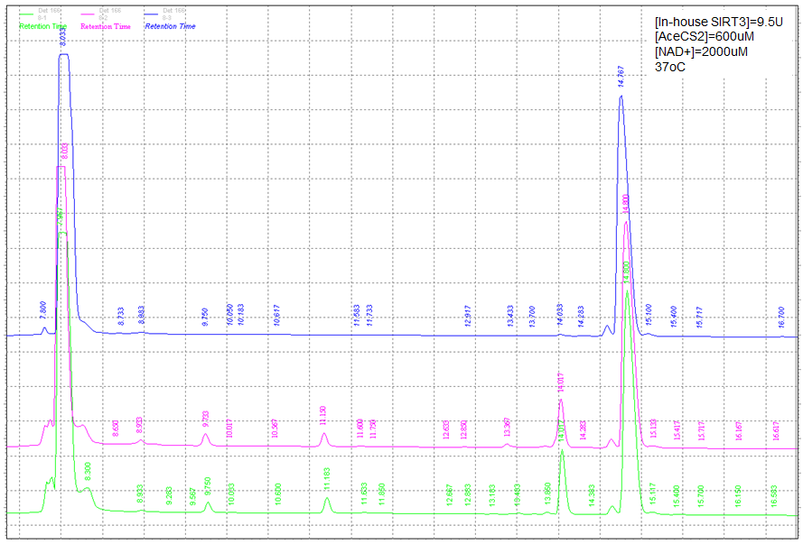
AceCS2

Slide 10
Remarks
Under sub saturating conditions, AceCS2 peptide deacetylated more efficiently by in-house SIRT3.
Under saturating conditions, AceCS2 peptide deacetylated more efficiently by in-house SIRT3.
The conditions selected from AU experiments, down the line, therefore, the current data can be used for comparison of the performance of Old HPLC+ New column vs. New HPLC + old column.

