Slide 1
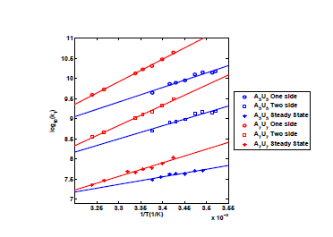
FIGURE 1

Slide 2
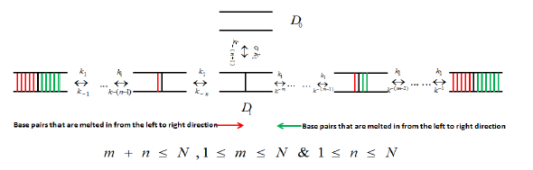
FIGURE 2

Slide 3
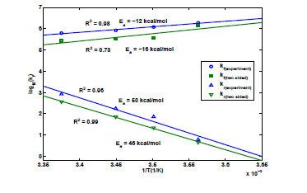
FIGURE 3

Slide 4
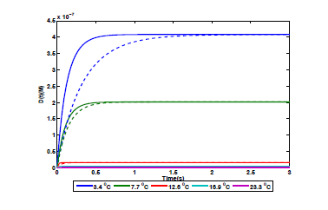
FIGURE 4

Slide 5
FIGURE 5. Predicted evolution of reaction species during a typical primer annealing reaction

Slide 6
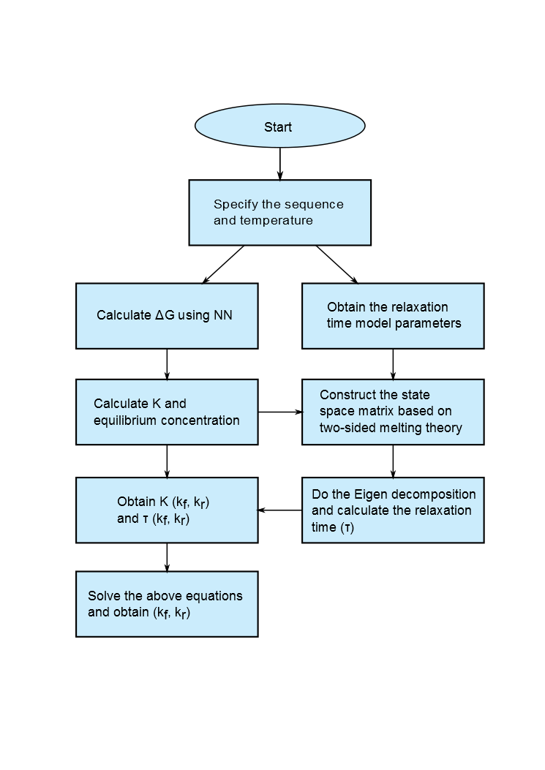
FIGURE 5. Flowchart for calculation of annealing rate constants

Slide 7
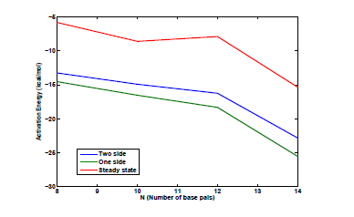
FIGURE 6

Slide 8
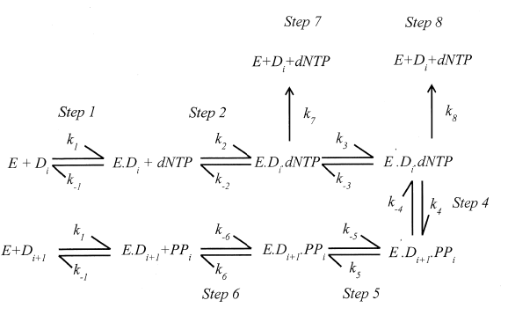
FIGURE 7. Reaction scheme for polymerase-mediated DNA extension. (k₁,k₋₁ in this
scheme are denoted k_{e},k_{-e} in the text.)

Slide 9
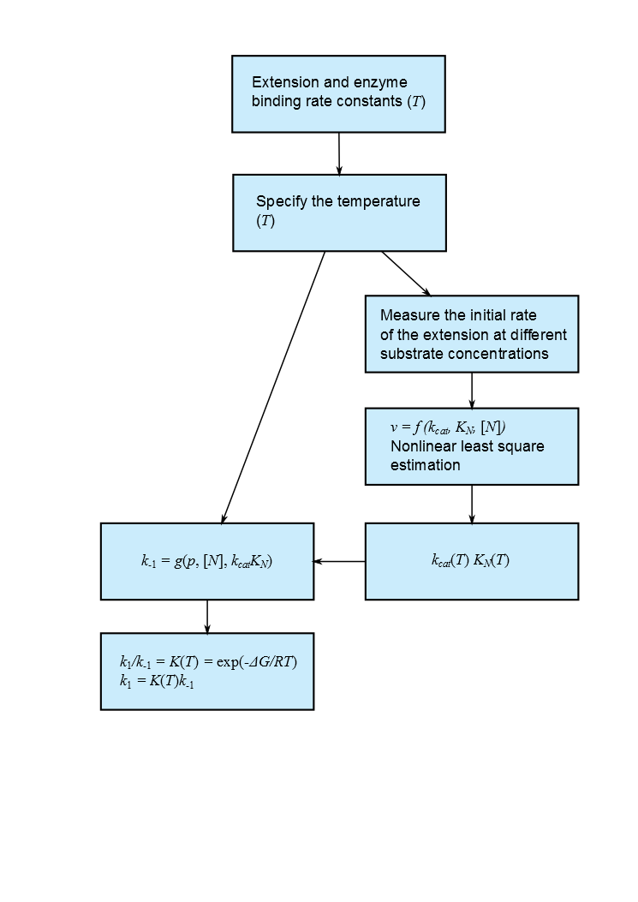
FIGURE 8. Flowchart for calculation of polymerase extension rate constants (k₁,k₋₁ in this scheme are denoted k_{e},k_{-e} in the text.)

Slide 10
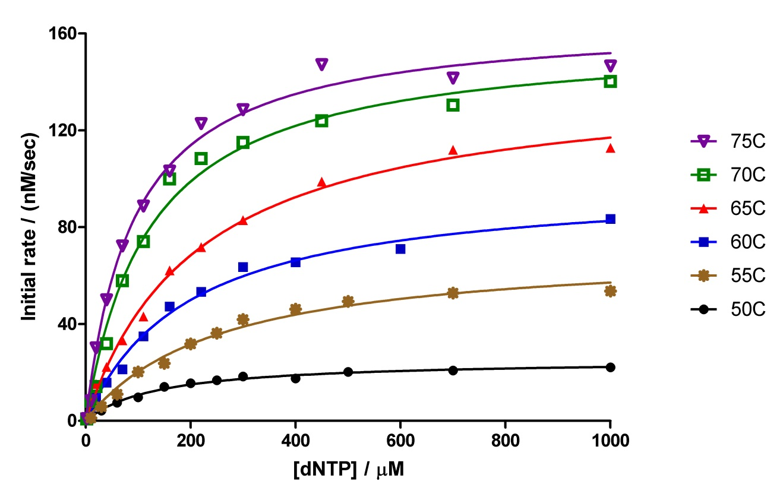
FIGURE 9

Slide 11
FIGURE 10

Slide 12
FIGURE 11

Slide 13
FIGURE 12

Slide 14
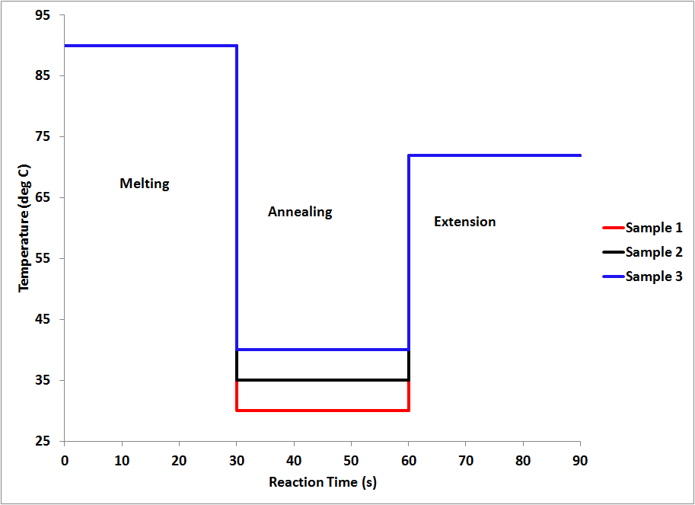
FIGURE 13

Slide 15
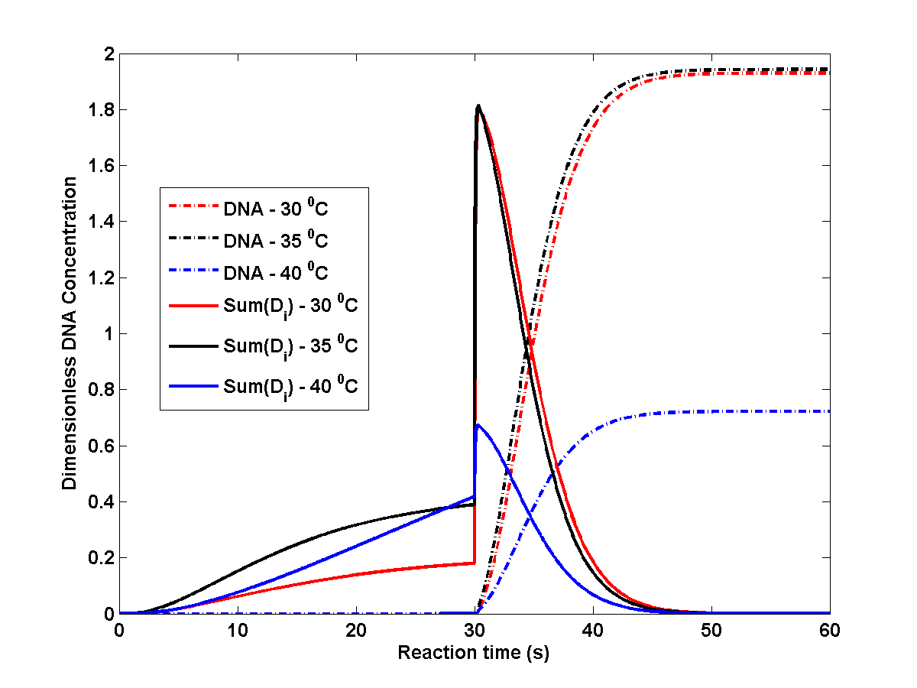
FIGURE 14

Slide 16
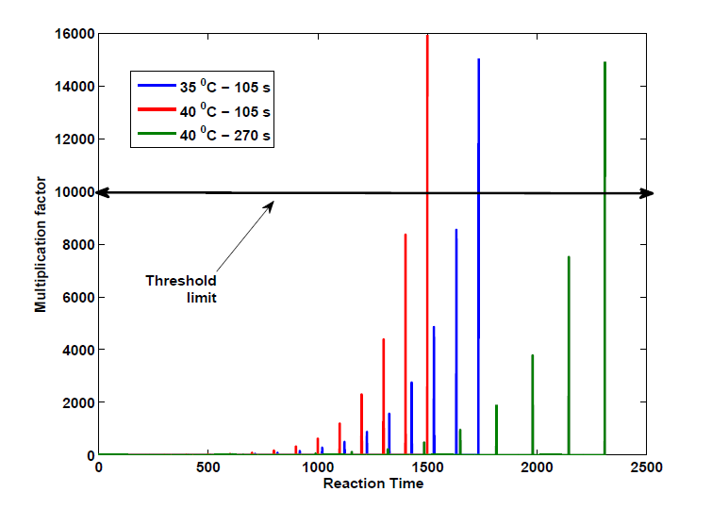
FIGURE 15

Slide 17
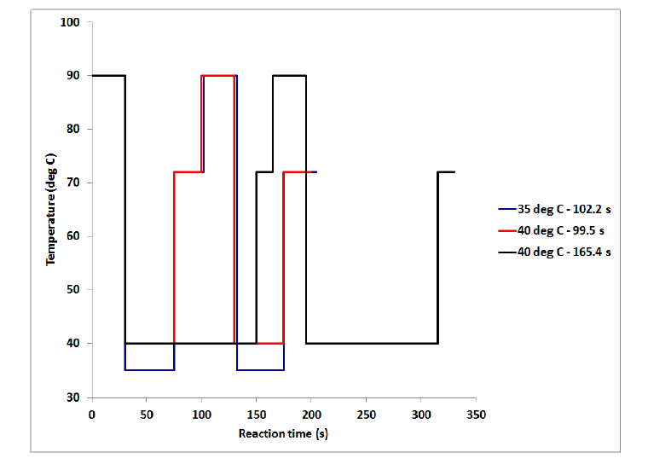
FIGURE 16

Slide 18
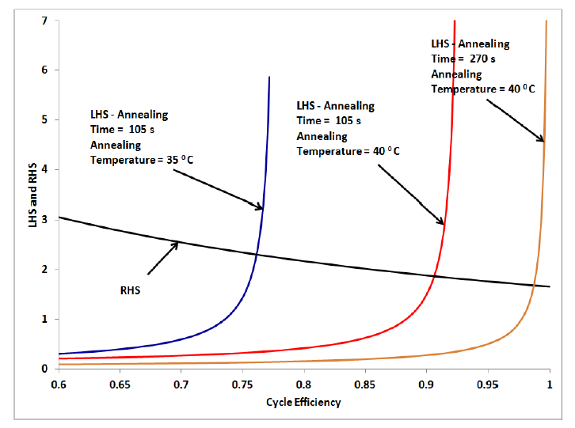
FIGURE 17

Slide 19
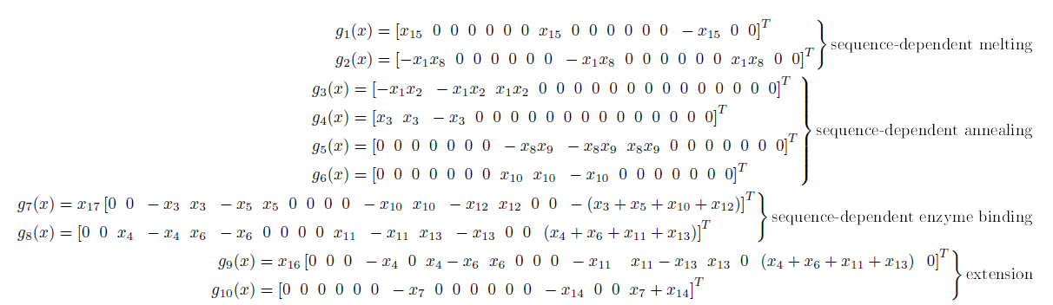
FIGURE 18

Slide 20
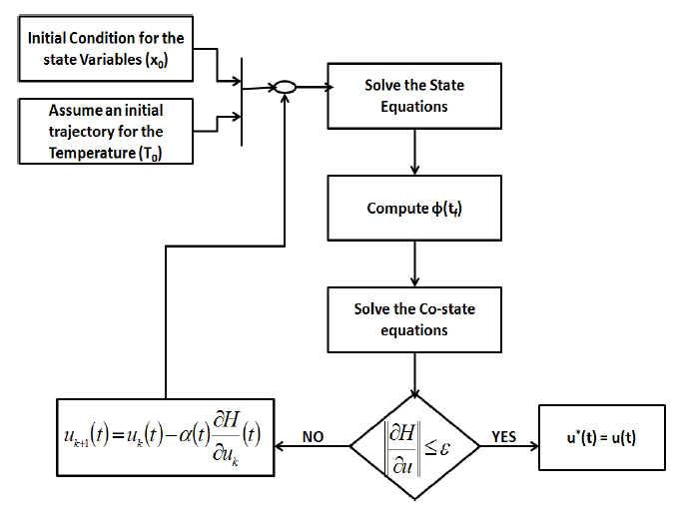
FIGURE 19

Slide 21
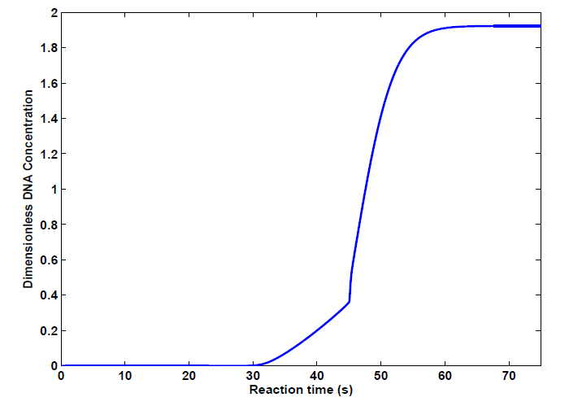
FIGURE 20

Slide 22
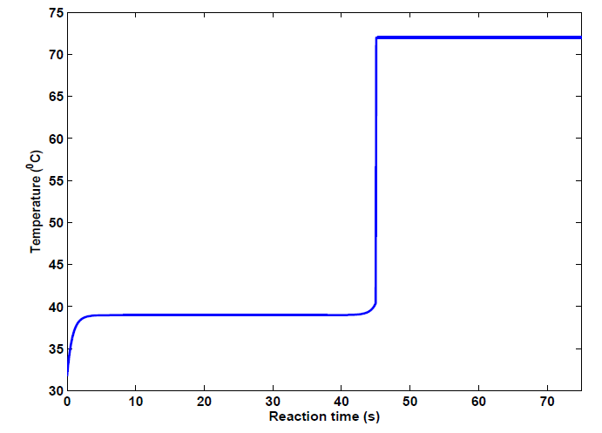
FIGURE 21

Slide 23
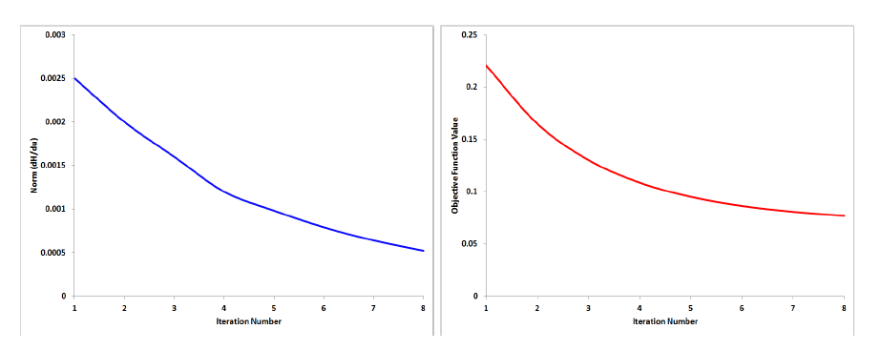
(a)
(b)
FIGURE 22

