Slide 1
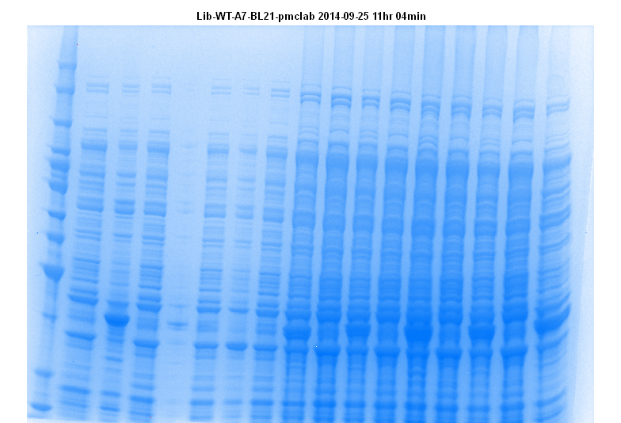
BL21 transformation & protein expression
2% O/N Saturated culture inoculated
in 150 µL in duplicate
Grown for 2 hrs, 37^{O}C, 250 RPM
IPTG added, 1 mM
Grown for 3 hrs, 37^{O}C, 250 RPM
Bacteria harvested, lysed by 20 µL BugBuster
reagent+ LDS buffer
Heat 90^{O}C, 10 Minutes, sonicate,
load on gel, Run 170V, ~1hrs, stain
40 Kda →
WT-A
A1
A2
A3*
A4*
A5*
A6*
A7*
Clones expressing β-Lactamase A3, A4, A5, A6, A7

Slide 2
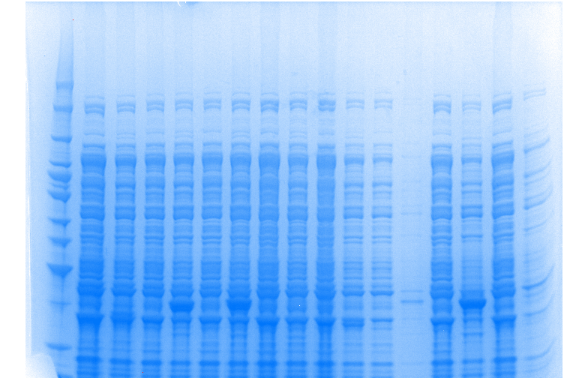
Protein expression…
40 Kda →
A8
A9*
A10*
A11
A12
B1
B2*
B3
Clones expressing β-Lactamase: A9, A10, B2

Slide 3
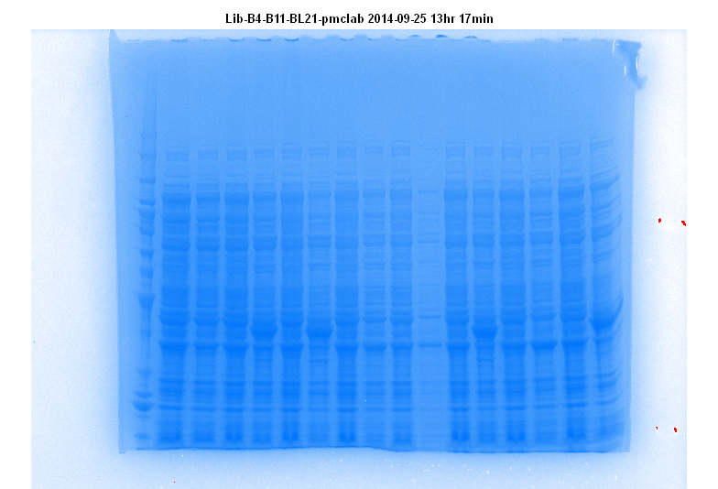
Protein expression…
40 Kda →
B4 B5* B6* B7 B8 B9* B10 B11*
Clones expressing β-Lactamase: B5, B6, B9, B11

Slide 4
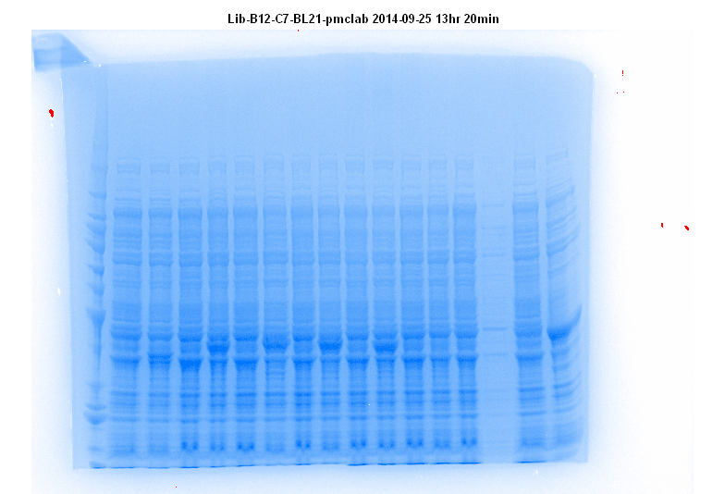
Protein expression…
40 Kda →
B12 C1* C2* C3* C4* C5 C6 C7*
Clones expressing β-Lactamase: C1, C2, C3, C4, C7

Slide 5
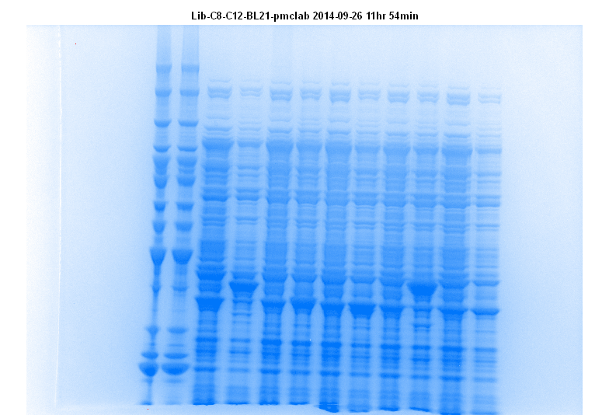
Protein expression, Summary
β-Lactamase positive clones (19/36)
A3, A4, A5, A6, A7, A9, A10
B2, B5, B6, B9, B11
C1, C2, C3, C4, C7, C8, C11
40 Kda →
C8* C9 C10 C11* C12
Clones expressing β-Lactamase: C8 and C11

Slide 6
40 kDa →
WT* WT* D1 D2 D3 D4* D5* D6*
β-Lactamase positive clones: D4, D5, D6

Slide 7
40 kDa →
*
D7* D8 D9* D10 D11 D12* E1 E2
β-Lactamase positive clones: D7, D9, D12

Slide 8
40 kDa →
E3* E4 E5* E6* E7 E8* E9 E10
β-Lactamase positive clones: E3, E5, E6, E8

Slide 9
40 kDa →
E11 E12 F1 F2 F3* F4* F5* F6*
β-Lactamase positive clones: F3, F4, F5, F6

Slide 10
**Reverse Loading
* *
40 kDa →
F7* F8* F9* F10 F11* *F12* WT* WT*
β-Lactamase positive clones: F7, F8, F9, F11
β-Lactamase positive clones:
D4, D5, D6, D7, D9, D12
E3, E5, E6, E8
F3, F4, F5, F6, F7, F8, F9, F11
*F12*: False positive colony?? (no growth observed)

Slide 11
Protein expression summary
IPTG induced protein corresponding to β-Lactamase molecular weight size (37/72)
A3, A4, A5, A6, A7, A9, A10
B2, B5, B6, B9, B11
C1, C2, C3, C4, C7, C8, C11
D4, D5, D6, D7, D9, D12
E3, E5, E6, E8
F3, F4, F5, F6, F7, F8, F9, F11

