Slide 1
Au23-Sirt3-Honokiol-60 min, 5ul Sirt3 (40U)
NAD+ | 100 uM
peptide | 100 uM
37 degree
60 min
Sirt3 | 5 uL (40 U)

Slide 2
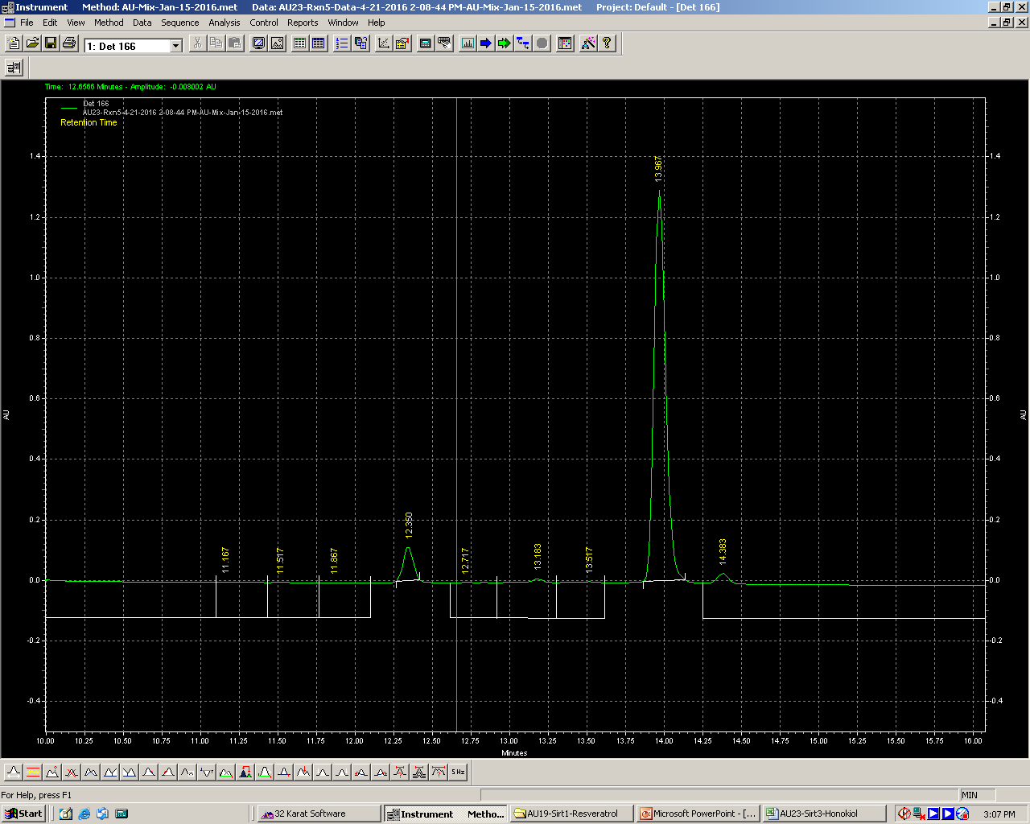
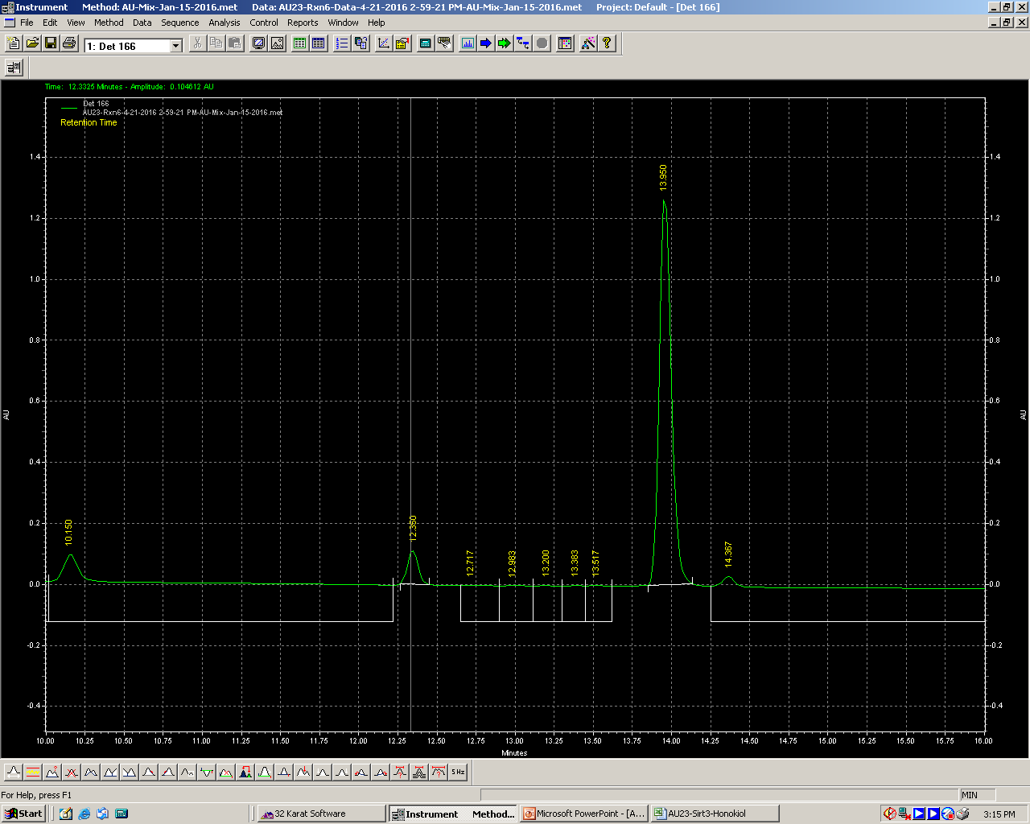
AU23- Sirt3 with 10 uM Honokiol
Sirt3-1%DMSO
Sirt3-10uM Honokiol
 | 100 NAD, 100 uM FdL; 40U Sirt3 (5ul of 8U/uL), 60 min, 37 degree
 | AU23-Rxn4-Blank (DMSO) | AU23-Rxn5-1% DMSO | AU23-Rxn6-10uM Honokiol
Substrate Rt | 13.95 | 13.967 | 13.95
Product Rt |  | 12.35 | 12.35
Substrate area | 7379485 | 6719241 | 6809508
Product area |  | 480803 | 507829
Total | 7379485 | 7200044 | 7317337
% Product | 0 | 6.677778636 | 6.940079431

