Slide 1
Experiment AU38
Following experiment was done as indicated in the task #4 of the schedule.
Endpoint assays (two time points; 5 and 30 min, 10U/rxn)
4: Assay non-saturating NAD & saturating peptide
4a: 100 uM NAD, 600 uM p53, 1% DMSO (2rxn)
4b: 100 uM NAD, 600 uM p53, 10 uM Honokiol (2rxn)
5: Assay non-saturating peptide & saturating NAD
5a: 2 mM NAD, 50 uM p53, 1% DMSO (2rxn)
5b: 2 mM NAD, 50 uM p53, 10 uM Honokiol (2rxn)
It appears that there is no activation of Sirt3 by 10 µM of Honokiol on p53 peptide. There might be some variation (less than 10%) in final data which might be due to experimental error.
To conclude that 10 µM Honokiol does not activate Sirt3 on p53, the experiment should be repeated for confirmation and reproducibility.
Using similar substrate conditions and 5 minutes time, Honokiol dose dependence experiment will be performed (as indicated in Task #6 of the schedule).

Slide 2
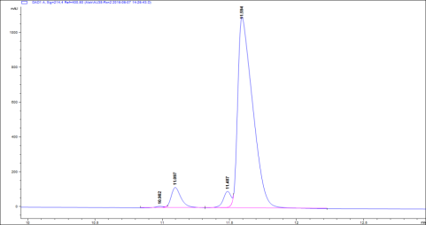
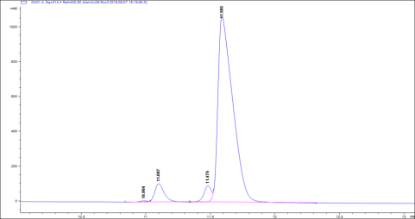
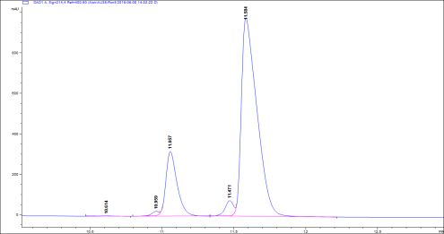
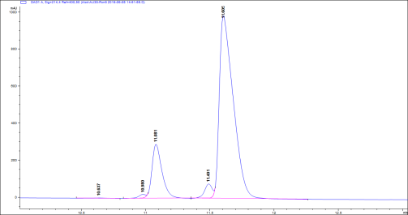
AU38-Rxn2, 3, 5, and 6
Rxn2
Rxn3
Rxn5
Rxn6
10U/Rxn Sirt3 (Enzo) | 2 mM NAD, 50 uM pep1 (p53)
 |  | 5 minutes |  | 30 minutes
 | Rxn1-Blank | Rxn2 | Rxn3 | Rxn5 | Rxn6
Product Rt (Min) | 0 | 11.097 | 11.097 | 11.057 | 11.081
Substrate Rt (Min) | 11.587 | 11.594 | 11.589 | 11.584 | 11.605
Product Area | 0 | 599 | 544 | 1741 | 1592
Substrate Area | 8775 | 8477 | 8517 | 7414.7 | 7486
Total Area | 8775 | 9076 | 9061 | 9155.7 | 9078
% product formed | 0 | 6.599824 | 6.003752 | 19.01548 | 17.5369
pmoles product | 0 | 131.9965 | 120.075 | 380.3095 | 350.738
pmoles/min | 0 | 26.39929 | 24.01501 | 12.67698 | 11.69127

Slide 3
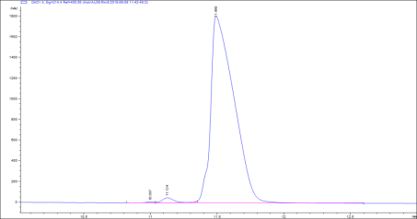
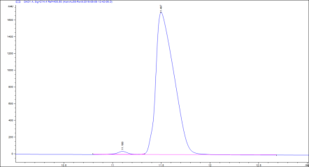
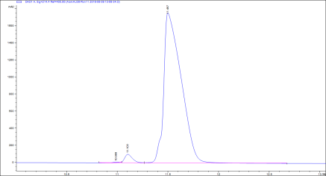
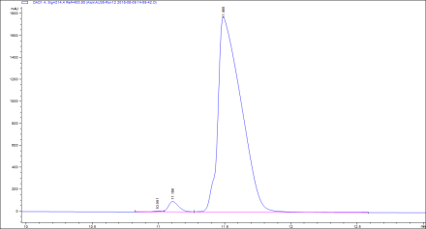
AU38-Rxn 8 and 9
Rxn8
Rxn9
Rxn11
Rxn12
10U/Rxn Sirt3 (Enzo) | 100 uM NAD, 600 uM pep1 (p53)
 |  | 5 minutes |  | 30 minutes
 | Rxn7-Blank | Rxn8 | Rxn9 | Rxn11 | Rxn12
Product Rt (Min) | 0 | 11.124 | 11.1 | 11.103 | 11.106
Substrate Rt (Min) | 11.375 | 11.49 | 11.497 | 11.497 | 11.488
Product Area | 0 | 299 | 319 | 564.4 | 535
Substrate Area | 21427.2 | 21815.7 | 22121.9 | 21008.3 | 21520
Total Area | 21427.2 | 22114.7 | 22440.9 | 21572.7 | 22055
% product formed | 0 | 1.352042 | 1.421512 | 2.61627 | 2.425754
pmoles product | 0 | 324.49 | 341.1628 | 627.9047 | 582.1809
pmoles/min | 0 | 64.89801 | 68.23256 | 20.93016 | 19.40603

