Slide 1
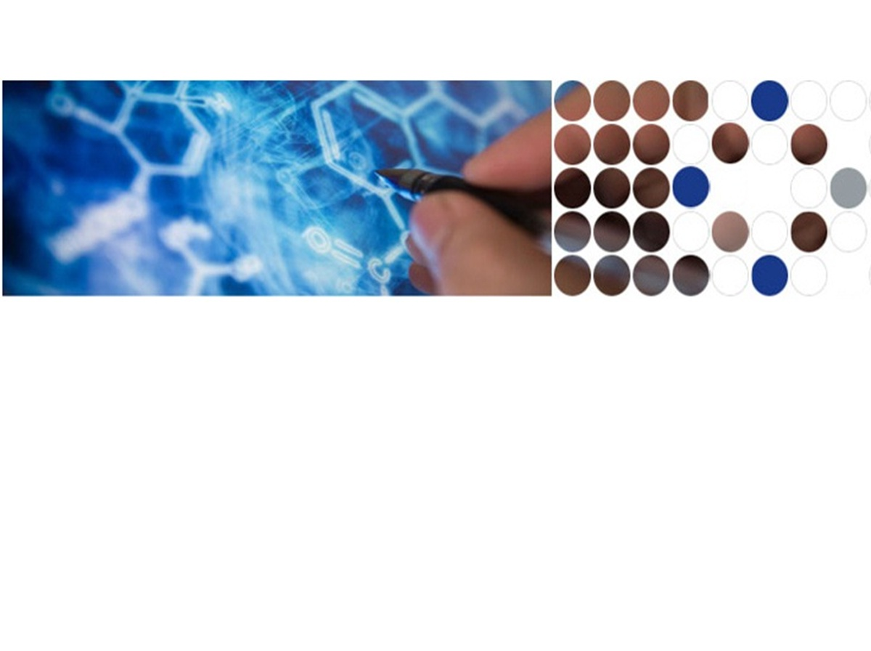
Mechanism of Human SIRT3 Inhibition by Nicotinamide
Xiangying Guan, PhD
Eric Knoll, PhD
Raj Chakrabarti, PhD*
PMC Advanced Technology, LLC
* Carnegie Mellon University

Slide 2
Outline
Background
Aging, Sirtuins
Importance of SIRT3
Target novel inhibitor of SIRT3
Inhibition modes
Mechanism of Sirtuins Deacetylase Reaction
Methods
Results from Wet Lab
NAM noncompetitively inhibits hSIRT1
NAM competitively inhibits hSIRT3
IsoNAM is a weak inhibitor for both hSIRT1 and hSIRT3
Potent inhibitor of hSIRT3
Results from Simulation
Future Direction
Notes:
We are developing a method for design inhibitor of hSIRT3. To better understand the system (binding site, inhibition mode et al), we studied the mechanism of NAM inhibition. NAM is a product inhibitor of Sirtuins. C binding pocket is NAM binding site. IsoNAM also can be docked into C pocket.

Slide 3





Many of the most important diseases that lead to disability and death occur late in life, indicating that aging itself is a key risk factor.
We are aging —not just as individuals or communities, but as a world
2050: 22% of population will be over 60
2050: from 605 million to 2 billion will be over 60
In the U.S., someone turns 60 every seven second
Is it possible to not only live longer, but healthier during our prolonged lives?
United Nations Department of Economic and Social Affairs, Population Division. World Population Prospects. The 2010 Revision, New York, United Nations, 2011.
Notes:
Between 2000 and 2050, the proportion of the world's population over 60 years will double from about 11% to 22%. The absolute number of people aged 60 years and over is expected to increase from 605 million to 2 billion over the same period.
Improving and extending quality of life among older Americans.

Slide 4
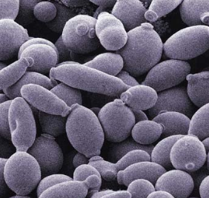
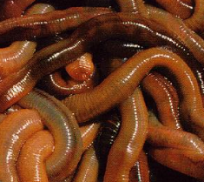
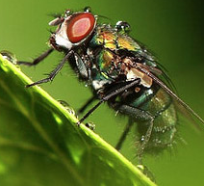
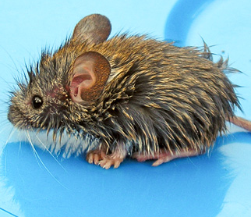


A decade ago…
Silent Information Regulator 2 (Sir2) was first identified in yeast as a lifespan regulator. Since then, many members of this family have been identified in species ranging from yeast to fly.
Sirtuins in other model organisms have been increasingly recognized as crucial regulators for a variety of cellular processes, ranging from energy metabolism and stress response to tumorigenesis and aging.
Yeast Worms fly mouse monkey human
Do mammalian sirtuins promote health and protect against aging-associated diseases?
Tissenbaum HA, and Guarente L. Nature (2001)410, 227-230.
Rogina B, Helfand SL. PNAS (2004) 101, 15998-16003.
Herranz D, Munoz-Martin M, et al. Nat Commun (2010) 1, 3.
Notes:
These are some of the central questions driving the field. Surprising progress has been made in only a decade of research on mammalian sirtuins. However, we are just beginning to understand the involvement of sirtuins in mammalian aging and age associated diseases, and our comprehension of many sirtuins remains rudimentary.

Slide 5
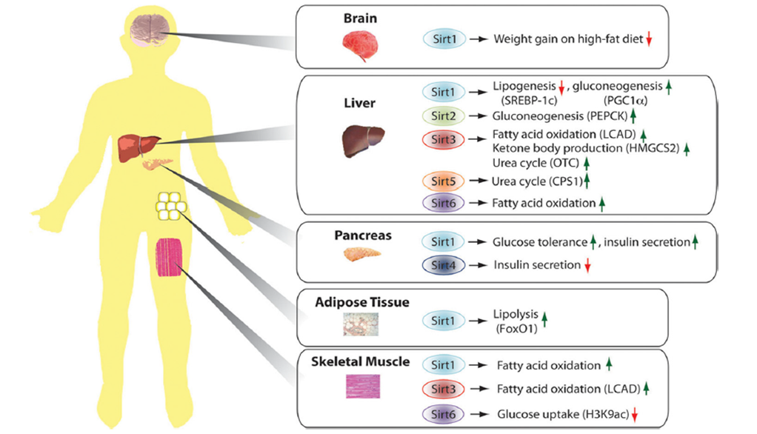
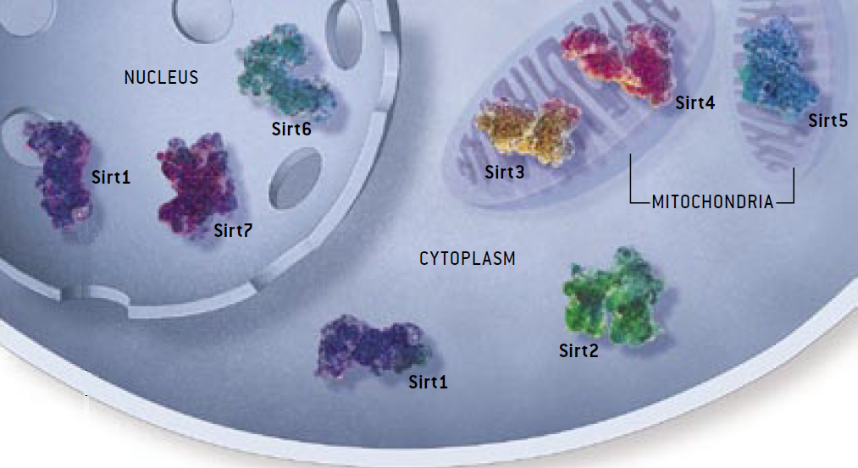
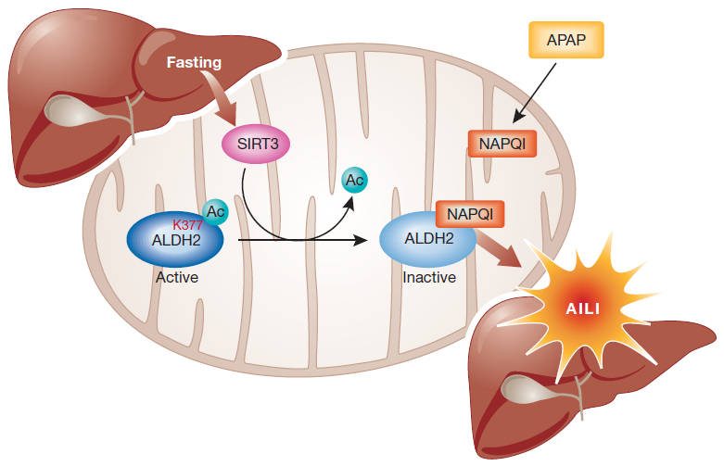
Sirtuin Family
Understanding the properties of the inhibitory mechanism
Elucidation of the mechanism of SIRT3 mediated deacetylation
Improvements in inhibitor selectivity and affinity
Potential therapeutic agents.
Only SIRT3 has been reported to be associated with an extended lifespan of man by regulating its expression.
Increased level of SIRT3 associated with node-positive breast cancer; oral squamlors cell carcinoma; as well as acetaminophen-induced liver injury.
Sinclair, DA and Guarente L (2006) Scientific American 48-57.
Frye, R.A. (2000) Biochemical and Biophysical Research Communications, 273, 793–798.
Alhazzazi TY et al. (2011) Biochim Biophy Acta. 1816, 80-88.
Lu Z et al (2011) EMBO Rep 12:840-846.
Notes:
There are seven human sirtuins, SIRT1–7 with diverse subcellular localization. SIRT1, SIRT6, and SIRT7 are nuclear proteins. SIRT1 can also shuttle between cytosol and the nucleoplasm. SIRT3, SIRT4, and SIRT5 are found in mitochondria, and SIRT2 is primarily in cytoplasm.
The Sirt1 enzyme is the best characterized Sirtuin, deacetylating other proteins and thereby altering their behavior. Metabolic functions of mamalian sirtuins in different tissues. Brain, Liver, Pancreas, Adipose Tissue, Skeletal muscles.
Among these 7 sirtuins, only SIRT3 has been reported to be associated with an extended lifespan of man by regulating its expression. Increasing SIRT3 activity will promote breast cancer, oral cancer and direct liver injury. Understanding the properties of the inhibitory mechanism will give support to the elucidation of the mechanism of SIRT3 mediated deacetylation and allow improvements in inhibitor selectivity and affinity. In this way, its inhibitors are of interest not only as tools for elucidating in detail the biological functions of the enzyme, but also as potential therapeutic agents.
---------------------------------------------------------------------------------------------------------------------------------------------------------------------------------------
Among them, only SIRT3 has been reported to be associated with an extended lifespan of man by increasing expression. Sirt3 is a mitochondrial deacetylase. Human sirtuin type 3 (SIRT3), one of the seven mammalian sirtuins so far identified, is a major mitochondrial protein and has an NAD⁺ -dependent deacetylase activity regulating the globe mitochondrial lysine acetylation. It has been reported that SIRT3 promotes cell survival and protects cells from cellular damage. Given that SIRT3 expression decreased with aging, and that mitochondrial reactive oxygen species (ROS) are important in cancer, SIRT3 plays a role in cancer development or prevention.
Whether SIRT3 serves as a tumor promoter or suppressor has been wildly discussed. On one hand, increased levels of SIRT3 associated with node-positive breast cancer versus non-malignant breast tissue as well as with oral squamlors cell carcinoma, suggesting that SIRT3 could function as a tumor promoter.
SIRT3-mediated exacerbation of acetaminophen-induced liver injury. SIRT3 deacetylates Lys 377 of ALDH2, making it available for NAPQI binding, which de-activates it. The concomitant reduction in the aldehyde-detoxifying activity of ALDH2 aggravates liver injury. AILI, acetaminophen-induced liver injury; ALDH2, aldehyde dehydrogenase 2; NAPQI, N‑acetyl‑p-benzoquinoneimine.
Given the known increase in SIRT3 activity on nutrient depreivation, they proposed that, if protein acetylation inhibits NAPQI binding, SIRT3 mediated deacetylation might aggravate acetaminophen-induced liver injury (AILI).
5

Slide 6
Reversible modes of inhibitor interactions with enzymes
Competitive Inhibition
S
S
Nonompetitive Inhibition
S
E
ES
S
S
Unompetitive Inhibition
S
I
E
ES
E
ES
I
I
I
S
I
EI
S
I
I
EI
S
ESI
I
ESI
Segel IH. Enzyme kinetics. (1993) John Wiley & Sons, Inc., Hoboken, New Jersey.
Copeland RA. Evaluation of enzyme inhibitors in drug discovery (2005) John Wiley & Sons, Inc., Hoboken, New Jersey.
Notes:
Understanding the properties of the inhibitory mechanism will give support to the elucidation of the mechanism of Rirtuins mediated deacetylation and allow improvements in inhibitor selectivity and affinity. The search for potent and selective compounds to inhibit specific Sirtuins is still in progress and much less is known about the consequences of Sirtuin inhibition.
Most drugs bind to their enzyme target through reversible interactions. Three potential modes of inhibitor interactions with enzymes. An inhibitor that binds exclusively to the free enzyme is called competitive inhibitor, these inhibitors compete with substrate for the pool of free enzyme molecules. A noncompetitive inhibitor is one that displays binding affinity for both the free enzyme and the enzyme-substrate complex or subsequent species. A noncompetitive inhibitor is one that displays binding affinity for both the free enzyme and the enzyme-substrate complex or subsequent species.

Slide 7
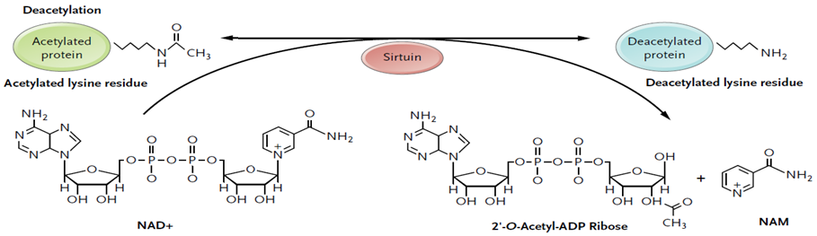
Sirtuin NAD⁺-dependent deacetylase chemistry
MS, HPLC for quantitatively measurement of one or more product;
Radioactive Assay ([³H]- or [¹⁴C]- labeled acetyl groups in the moiety of the peptide) for
scintillation counting;
NAD⁺ bioluminescence assay;
Fluorescence-based Assay for quantitatively measurement of fluorescent labeled deacetylated
peptide - Fluor de Lys fluorogenic assay;
Experimental Assay Computational Simulation
BIOMOL Assay Induced Fit Docking
PNC1/GDH Assay Binding Affinity (MM-GBSA)
Michan S and Sinclair D(2007) Sirtuins in mammals: insights into their biological function. Biochem J 404, 1-13.
Haigis MC (2006) Mammalian sirtuins-emerging roles in physiology, aging, and calorie restriction. Genes Dev 20, 2913-2921
Notes:
The NAD⁺-dependent deacetylation begins with a necleophilic attack of the carbonyl oxygen of acetyl-lysine on the C1’ of the nicotinamide ribose (N-ribose) or NAD⁺, which results in recharged o-alkyl-amidate intermediate. Then lead to the production of OAADPr and deacetylated lysine.
Nicotinamide, a well known sirtuin inhibitor, is a water-soluble vitamin of the B complex, which together with nicotinic acid belongs to vitamin B3 and it acts as constituent of the enzyme cofactors NAD (nicotinamide adenine dinucleotide) and NADP (nicotinamide adenine dinucleotide phosphate) (pyridine nucleotides). These molecules function as electron carriers in cell metabolism of carbohydrates, fatty acids and amino acids. Nicotinamide has been used to treat pellagra and is the most powerful neuroprotective agent in clinical use.
Nicotinamide is the physiological sirtuin inhibitor. The IC50 values of nicotinamide inhibition of bacterial Sir2, yeast Sir2, mouse Sir2, human SIRT1, SIRT2 and human SIRT3 were 26, 120, 160, 50, 100, 36.7*uM, respectively Nuclear nicotinamide levels has been estimated to be 10-150 uM, which most likely make NAM as Sirtuin activity regulator in vivo.
Interestingly, NAM is the physiological regulator of human sirtuins and is a reaction product and endogenous noncompetitive inhibitor of yeast Sir2 protein.
Nicotinamide is a form of vitamin B3 and is required for normal life. Nicotinamide deficiency is called pellagra and is marked by diarrhea, dementia and dermatitis. Pellagra is fatal due to neurodegeneration unless nicotinamide is administered. Nicotinamide is the most powerful neuroprotective agent in clinical use. Several rodent studies have provided data suggesting a use for the combination of nicotinamide and ketamine in recovery from stroke. Senescent patients tend to be nicotinamide deficient, not nicotinamide over medicated. Therefore, it seems very unlikely that nicotinamide inhibition of sirtuins could be a major factor in shortening lifespan in man and animals.

Slide 8
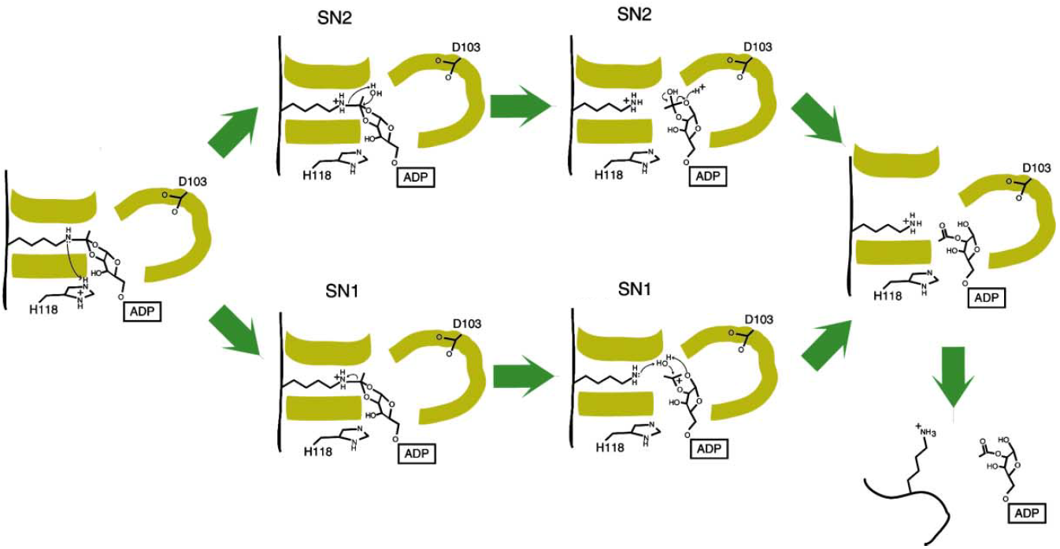
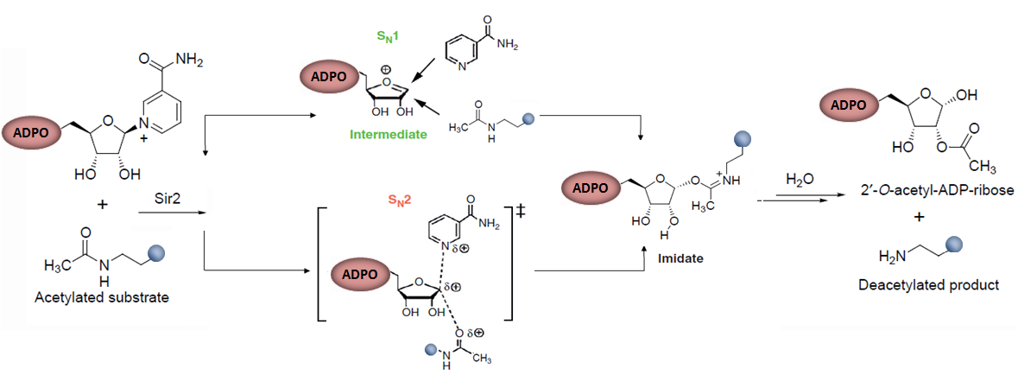
Mechanism of Sirtuin deacetylation
Sauve AA, Youn DY. Current Opinion in Chemical Biology (2012) 16, 535-543.
Avalos JL, Boeke JD, Wolberger C. Mol. Cell (2004) 13: 639-648.
Notes:
Mechanisms of reaction of NAD+ with acetyllysine nucleophile. Three mechanistic possibilities can be considered for reaction of acetyllysine with NAD+, as shown by (SN1) and asynchronous SN2 reaction pathways. The SN1 mechanism proceeds through a discrete intermediate and the transition state for intermediate formation is not shown in this case. The transition states for the asynchronous SN2 mechanism is represented by chemical structures shown in brackets. Partial charges on groups at the transition state are shown by d+ symbols to qualitatively indicate group (group: nicotinamide, ribose and amide) charges determined by computational studies.
(D1) His118, acting as a base, activates the 2OH for internal attack on the destabilizing charge, which cleaves theO-alkylamidate.
(D2) The product of this attack is a cyclic amino-acetal that needs to be protonated to proceed with the reaction in two possible mechanisms:
SN1 or SN2. (D3-SN1) The amino group leaves the intermediate, thereby cleaving the amide bond and producing a cyclic acyl-oxonium ion.
(D4-SN1) The lysine is protonated and the acyl-oxonium is hydrolized to produce 2O-acetyl-ADP-ribose. (D3-SN2) Water attacks the aminoacetal
intermediate to produce deacetylated lysine and a cyclic orthoester. (D4-SN2) In an acid-catalyzed reaction, the cyclic orthoester is
hydrolyzed to produce 2O-acetyl-ADP-ribose. (D5) The positive charge in the lysine lacking other covalent bonds causes the Aly binding
hydrophobic tunnel to open. (D6) As the Aly binding tunnel opens, the enzyme releases the deacetylated peptide.

Slide 9
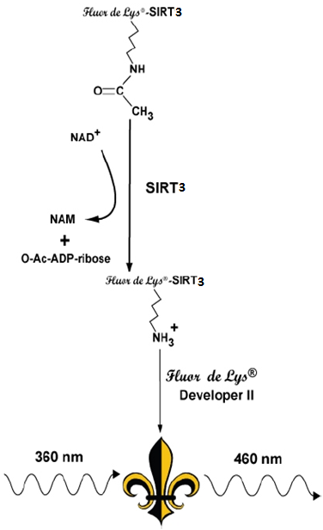
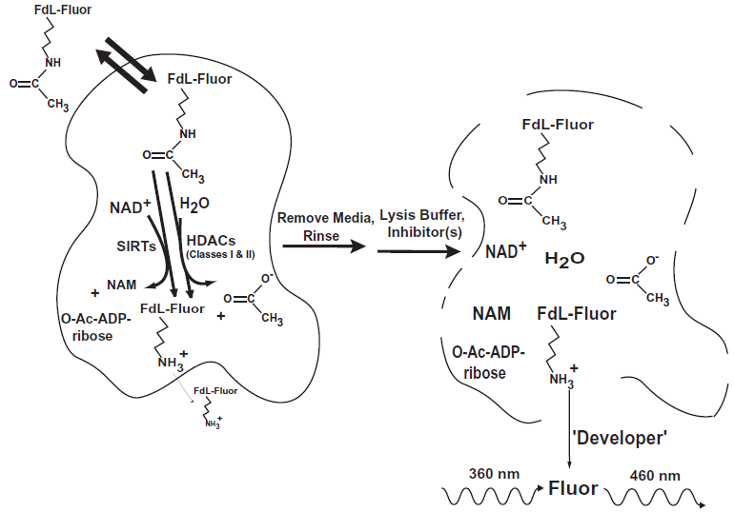
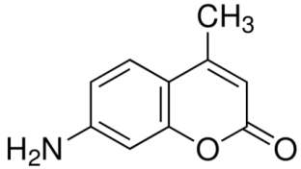
BIOMOL Assay
AMC
Howitz KT, et al (2003) Nature 425:191-196
Excitation 350-380 nm
Emission 450-480 nm
Notes:
7-amino-4-methylcoumarin

Slide 10
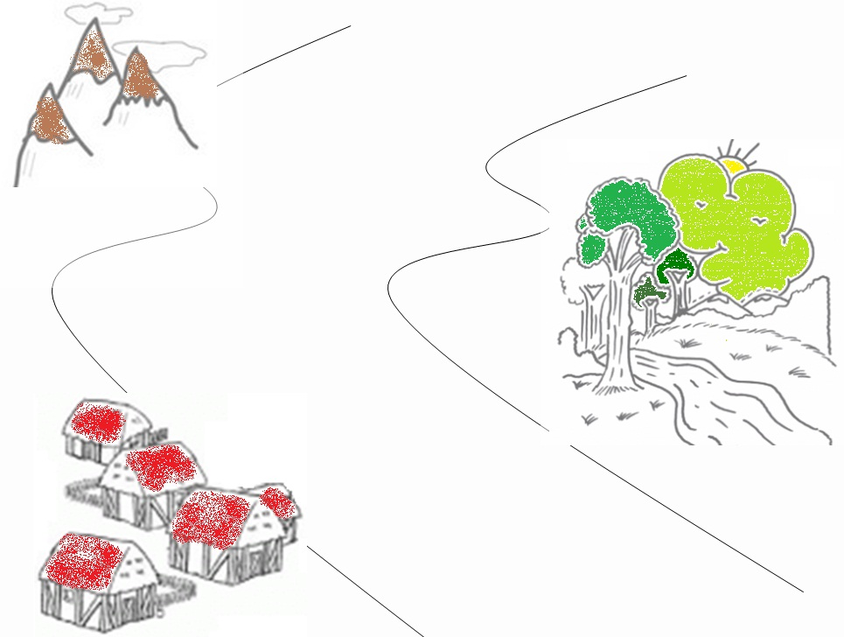
The contentious history of Sirtuin Debates
2013 Common mechanism of SIRT1 regulation by Allosteric activators
2010 STACs interact directly with SIRT1 and activate deacetylation by an allosteric mechanism.
2010 The presence of TAMRA label is necessary for activation SIRT1 by resveratrol along with SRT1460,
SRT1720, and SRT2183.
2007 Samll molecule activators, like resveratrol, can activate the SIRT1-catalyzed deacetylation as therapeutics for treatemtn of type 2 diabetes
Milne JC, Lambert PD, Schenk S, et al. (2007) Nature 450:712-716.
Pacholec M, Bleasdale JE, et al. J Bio Chem (2010) 285: 8340-8351.
Dai H, Kustigian L, et al J Bio Chem. (2010)285: 32695 – 32703.
Hubbard BP, Gomes AP, et al Science (2013) 339: 1216-1219.

Slide 11
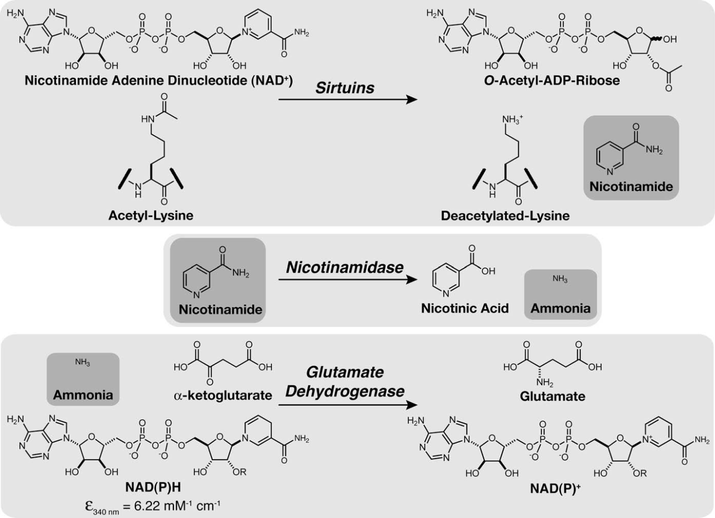
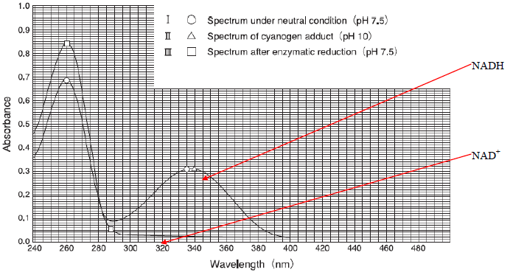
PNC1/GDH Assay
Smith BC, Hallows WC, Denu JM Anal Chem (2009) 394: 101-109.
Notes:
The rate of nicotinamide formation is measured using a coupled enzyme system with nicotinamidase and glutamatedehydrogenase. Nicotinamidase hydrolyzes nicotinamide to nicotinic acid and ammonia. Glutamate dehydrogenase then converts ammonia, a-ketoglutarate, and NAD(P)H to glutamate and
NAD(P)+. NAD(P)H oxidation/consumption is measured spectrophotometrically at 340 nm.

Slide 12
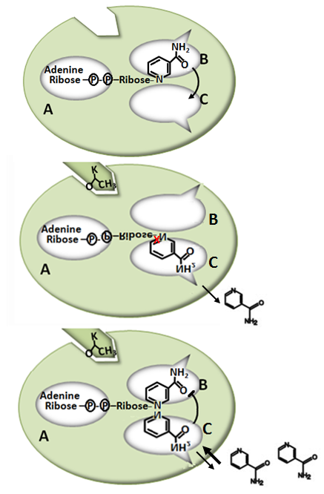
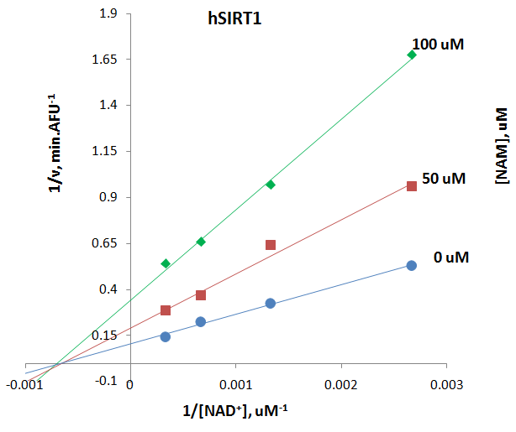

NAM noncompetitively inhibits hSIRT1
J Bio Chem (2002) 277:45099-45107.
Mol. Cell (2005) 17: 855-868.
Notes:
the Sir2 family of deacetylases contains an NAD binding pocket divided into three distinct regions. The adenine-ribose moiety of NAD binds the A site whereas, in the absence of acetylated substrate, the nicotinamide moiety is bound to the B site.
B, in the presence of an acetyllysine (K) a rotation around a phosphodiester bond of the pyrophosphate moiety would position the nicotinamide group near the C site where hydrolysis and subsequent nicotinamide release may take place.
C, when present at elevated levels, free nicotinamide may bind to the C site preventing the conformational change and hydrolysis of NAD.
Based on the reaction mechanism for Sir2 deacetylation and the crystal structure of an archeal Sir2 homologue, we propose the following model for Sir2 regulation by nicotinamide. Sir2-catalyzed deacetylation consists of two hydrolysis steps that are thought to be coupled. Cleavage of the glycosidic bond connecting nicotinamide to the ADP-ribose moiety of NAD is followed by cleavage of the C-N bond between an acetyl group and lysine. A recent structural analysis indicates that the NAD binding pocket of Sir2 enzymes contains three spatially distinct sites (A, B, and C), the later two of which are thought to be directly involved in catalysis (Crystal Structure of a SIR2 Homolog–NAD Complex. Min J, Landry J, et al (2001) Cell 105: 269-279.) (Fig. A). In the presence of an acetyllysine, NAD bound to the B site can undergo a conformational change bringing the nicotinamide group in proximity to the C site, where it may be cleaved (Fig. B). The ADP-ribose product of this reaction may then return to the B site where deacetylation of the acetyllysine occurs. We propose that nicotinamide binds to and blocks the internal C site, preventing the conformational change and subsequent cleavage of NAD (Fig. C).

Slide 13
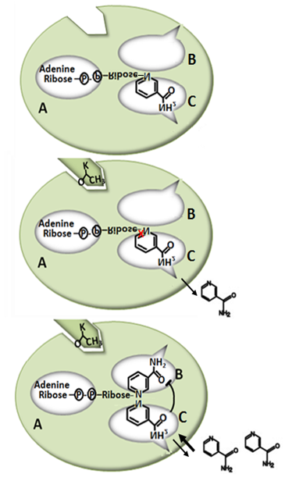
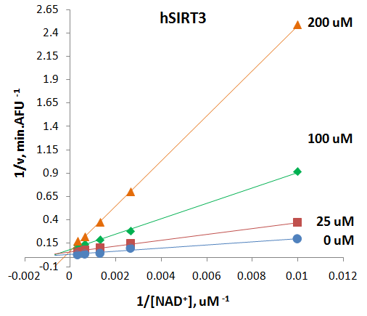

NAM competitively inhibits hSIRT3
X

Slide 14
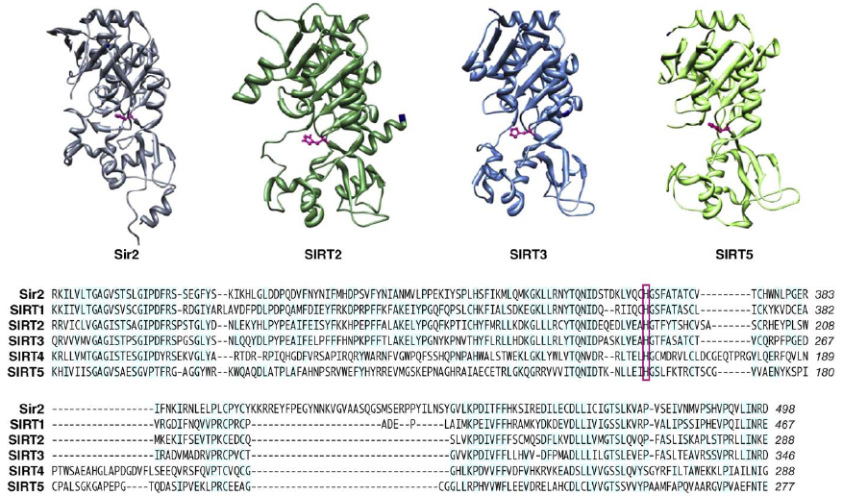
Structure and alignment of sirtuins
Verdin E, Hirschey MD, Finley LWS, Haigis MC. Review Trends in Biochemical Sciences Vol.35 No 671
Notes:
Three-dimensional structures of the sirtuin core domains from yeast Sir2 (pdb: 2hjh), mammalian SIRT2 , SIRT3 and
SIRT5 were generated using UCSF Chimera. In each structure, the catalytic histidine residue is highlighted in pink, and the N and C termini are shown in navy. Reference sequences for yeast Sir2 and mammalian SIRT1-5 were aligned by ClustalW and the region surrounding the catalytic core is shown with highly conserved amino acid residues shaded in blue and the catalytic histidine residue boxed in pink.

Slide 15
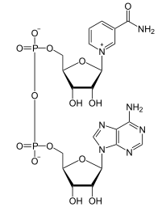
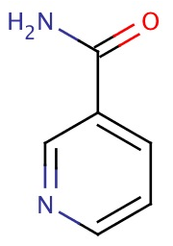
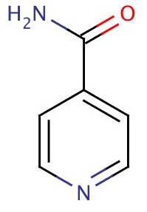
NAD+, NAM, isoNAM
NAD+
Nicotinamide adenine dinucleotide is a coenzyme found in all living cells
NAM
isoNAM

Slide 16
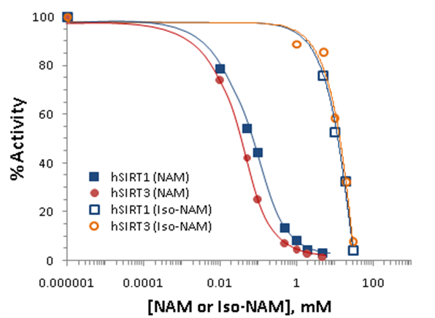
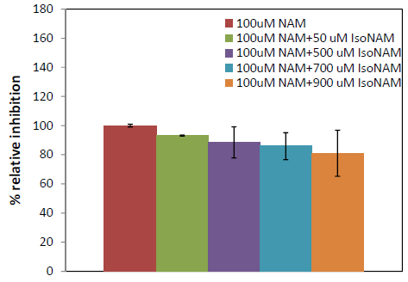
Human SIRT3 inhibition effect by NAM in the presence of isoNAM
The IC50 for the hSIRT3 enzyme is 36.7 uM, and that of the hSIRT1 enzyme is 68.1 uM
Notes:
Nicotinamide inhibition assays showing percent change in deacetylation activity as a function of nicotinamide concentration. Data for the hSIRT1 enzyme are indicated with close square and a blue curve; data for the hSIRT3 are indicated with filled circles and a red line.
Isonicotinamide was reported as an activator of Sir2 activity shown to directly compete with nicotinamide for binding. Nicotinamide is a potent inhibitor of the Sir2 reaction because of its ability to rebind with the enzyme and react with a high-energy intermediate, preventing deacetylation and regenerating starting materials. The basis for the observed activation is the relief of the inherent nicotinamide inhibition by competition with isonicotinamide, which does not readily react with the enzyme intermediate. Does the aforementioned rule of isoNAM fit on hSIRT3? The hSIRT3 inhibition effect by NAM was studied in the presence of different concentration of isoNAM. Figure shows that in the presence of isonicotinamide (50 uM - 900 uM), hSIRT3 inhibition of NAM was slightly decreased.

Slide 17
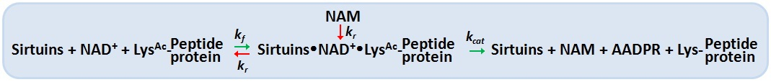
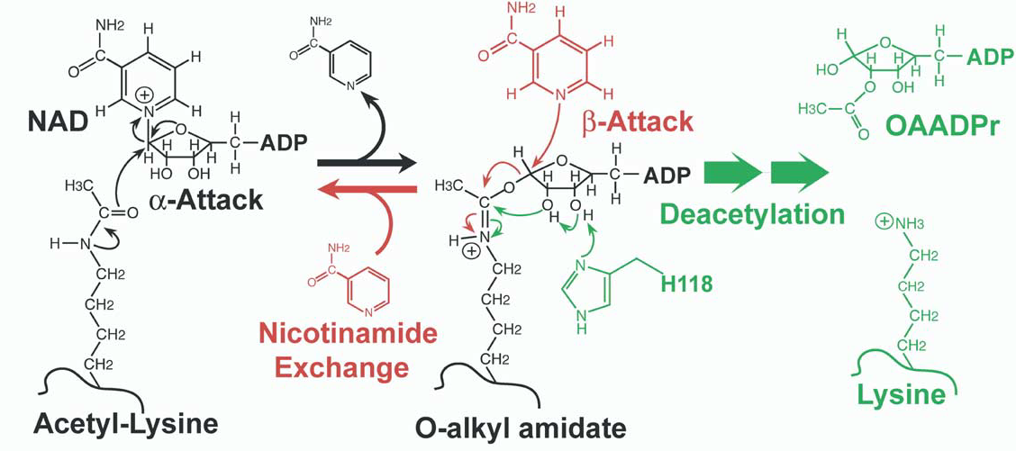
Mechanism of Sirtuin inhibition by NAM
Nicotinamide can react with the intermediate in a process known as nicotinamide exchange, in which NAD⁺ and acetyl-lysine are reforemed.
Denu JM (2003) Trends Biochem. Sci. 28: 41 - 48.
Sauve AA et al (2001) Biochemistry 40: 15456 – 15463.
Sauve AA et al (2003) Biochemistry 42: 9249 – 9256.
Sauve AA et al (2004) Curr. Med. Chem. 11: 807 – 826.
Jackson MD et al (2003) 278: 50985 – 50998.
Notes:
Nicotinamide has been used to inhibit cellular sirtuins in a wide variety of experiments in yeast and mammalian cells. The inhibition constants vary between homologs, but usually fall within the 20–200 uM range, which makes nicotinamide the most potent general inhibitor described to date.
The initial step of catlysis involves a nucleophillic attack of the carbonyl oxygen of acetyl-lysine on the D1’ of the N-ribose of NAD+. This step forms an o-alkylamidate that is consumed by the internal attack of its 2’ OH, activated by a conserved histidine, leading to deacetylation, or by the attack of a nicotinamide molecule on the beta face of its C1’, which leads to nicotinamide exchange and inhibition of deacetylation.
Few groups have been reported that NAM can react to regenerate acetyllysine and NAD⁺ in a nicotinamide exchange reaction, in which the imidate intermediate is emptied during normal steady-state turnover, directing NAM inhibition of deacetylation. By using [carbonyl-¹⁴C] nicotinamide the Base Exchange reaction for Sir2 was extensively studied.
The reactivity between Base Exchange and deacetylation reactions occurs when NAM is around. This competition partitions the intermediate forward and backward to provide inhibition of deacetylation. The independence of the deacetylation and base exchange reactions establishes that base exchange is a b-face nucleophile process, whereas deacetylation is an a-face nucleophilic process.NAM partition ratios are controlled by the relative rates of nucleophilic chemistry at the b-face versus the a-face of the intermediate. The exchange and deacetylation reactions share the intermediate forming step, and the ratio is determined by the chemical processes. It seems likely that unreactive isosteres of NAM that interfere with NAM binding could derepress sirtuin enzymatic activity and increase sirtuin function

Slide 18
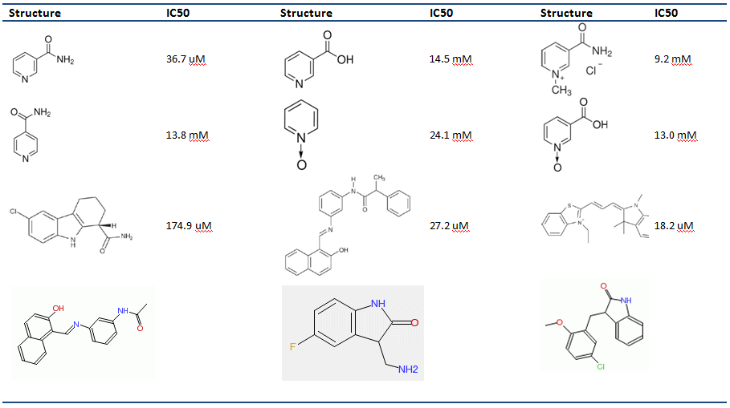
Inhibition effect of hSIRT3
Notes:
Strong inhibitors of hSIRT3 were found.

Slide 19
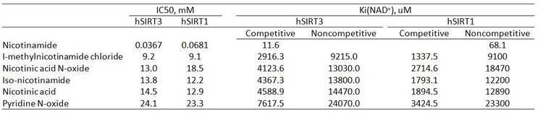
NAM analogs inhibition effect of hSIRT3
Combined with the other 6 molecules (Ex-527, Salermide, AC93253, CamBridge 5281087, 4102009, 9147724), it is possible to present the correlation MMGBSA vs. Experimental data here. We can show what we have done and what will be improved for the long term.

Slide 20
Simulation Methods
Objectives:
Elucidate competitive vs. non-competitive mechanisms
Design and virtually screen inhibitors
How:
Protein-ligand docking with GlideXP and Induced Fit Docking
  Poses and intermolecular contacts replicated for available co-crystallized structures in Sir2.
MM-GBSA
  More accurate binding affinity predictions than docking score

Slide 21
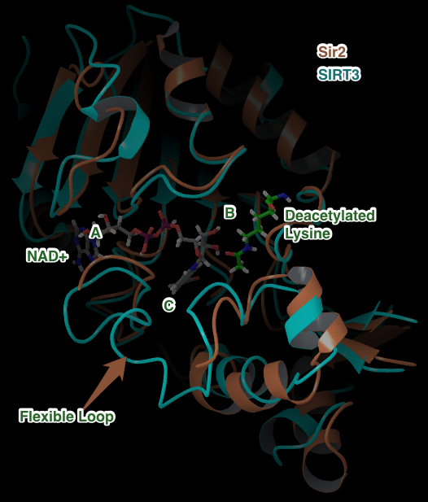
SIRT3 structure
Superposition with Sir2 backbone RMSD < 2.0
Flexible Loops different
NAD+ from Sir2 co-crystallized x-ray
A, B, C pockets shown are in a cleft between the two protein domains
Notes:
Verify RMSD between SIRT3 and Sir2….
Add details on discussion of differences between flexible loops

Slide 22
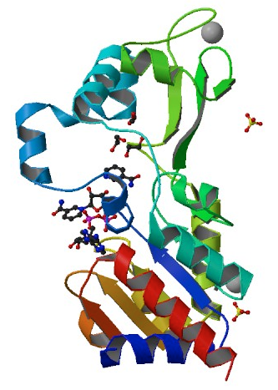
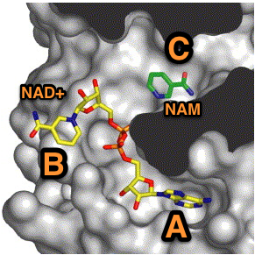
Active Site: A, B, C pockets
ZOOM
Sir2
Notes:
Space-filling model of Sir2-Af2 and nicotinamide inhibition. Nicotinamide (NAM) in green is shown bound in the “C-pocket” of Sir2-Af2 adjacent to an NAD+ molecule in the active site. Inhibition by NAM is proposed to occur when free NAM binds in the C-pocket and reacts with the relatively long-lived peptidyl intermediate, driving the reaction in reverse to generate NAD+ and acetylated target protein (image provided courtesy of C. Wolberger, Johns Hopkins Medical School).

Slide 23
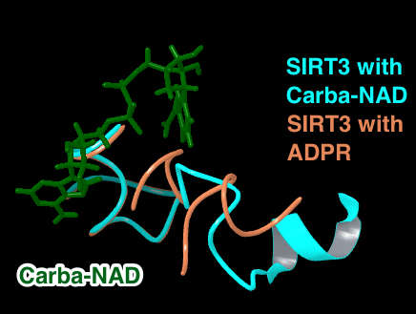
Loop Minimization
Do not need because of new SIRT3 crystal structure with Carba-NAD in AC pocket has loop closed in proper formation near C pocket.
Notes:
Note the missing residues from the loop in the SIRT3 with ADPR. In the new SIRT3 Carba-NAD, the loop is in the proper orientation.

Slide 24
Computational Methods: ∆G_{bind}
Standard docking with Glide
  Heuristic docking score optimized for finding correct ligand pose rather than correlation to absolute ∆G_{bind}
MM-GBSA
  ∆G_{bind} = ∆E_{MM} - ∆G_{SOLV} + ∆G_{SA}
  Improve by linear regression to experiment
  Best case scenario R² ~ 0.8, typical R²~0.3
  Benefits: fast, so can scan huge library, better than docking score alone
  Limitations: Does not include entropy, ligand or protein reorganization energy, explicit waters, etc.

Slide 25
Computational Methods: ∆G_{bind}
Induced Fit + MM-GBSA
  Improves docking by allowing for receptor side chain and backbone flexibility, but may add noise
LIA (linear interaction approximation)
  ΔG = α (<U^{b}_{vdw}> – <U^{f}_{vdw} >) + β (<U^{b}_{elec} > -<U^{f}_{elec}>) +
  γ (<U^{b}_{cav}> – <U^{f}_{cav}>)
  A linear response method (LRM) similar to LIE.
  Multiple linear regression (3 terms) fitted to at least 5 experimental ∆G_{bind}

Slide 26
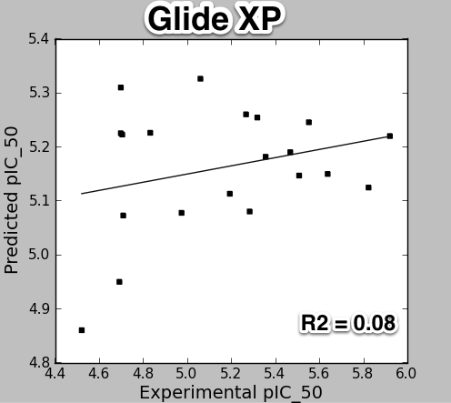
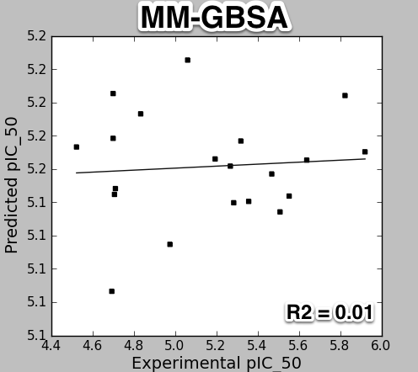
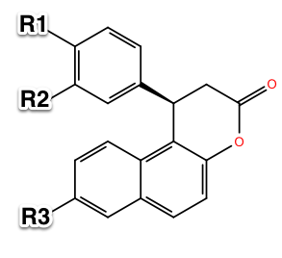
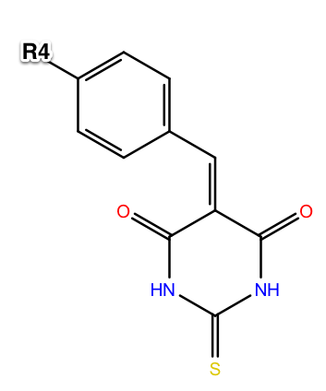
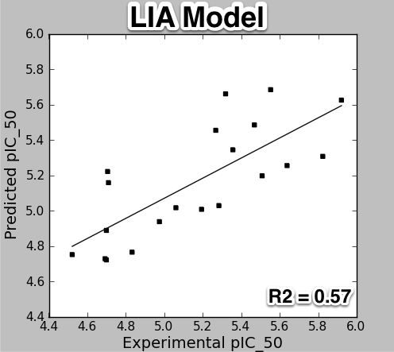
Binding Energy Prediction: SIRT2 Inhibitors
R = cyclopropyl, methyl, ethyl, propyl, bromo, fluoro, iodo, nitrile, etc
Uciechowska, Jung, Sippl, et.al. ChemMedChem 2008, 3, 1965.
Notes:
Chose SIRT2 as test case because good co-crystallized structures and experimental data available.
Following 4 figures of experimental ∆G_bind vs. computed, each a different method
Glide scores
MM-GBSA – standard, without induced fit or and without side chain or backbone optimization. Calculate MM-GBSA energy straight from GlideXP poses.
Induced Fit MM-GBSA – taking too long to run with limited number of licenses.
LIA from Liaison
Starting X-ray crystal structure:
1J8F, SIRT2; not a co-crystallized structure with an inhibitor – this is not available.
1J8F was starting structure for other papers, so I used the same.
3ZGV was a later structure available at beg. Of 2013 that has ADPR trapped intermediate. Possibly a better starting structure for simulations.
Ligands and experimental data from 2008 reference.

Slide 27
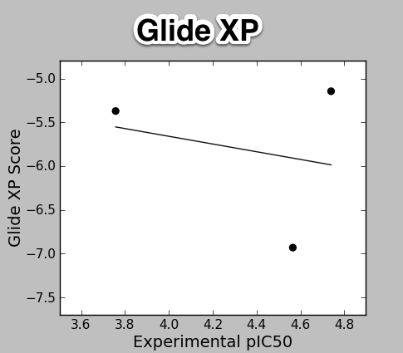
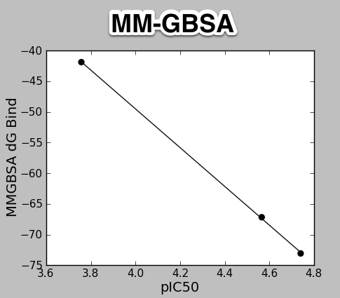
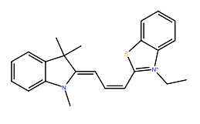
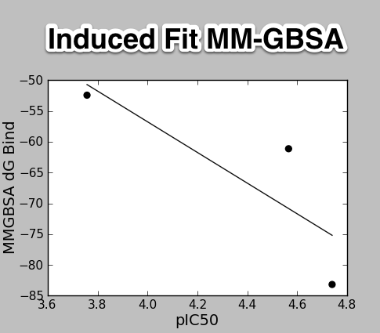
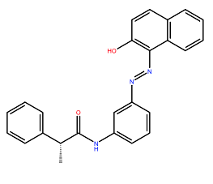
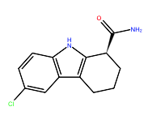
Binding Energy Prediction: SIRT3 Inhibitors
3 Tested High Affinity
Ligands: Ex-527,
Salermide, AC93253
Notes:
Following 4 figures of experimental ∆G_bind vs. computed, each a different method
Glide scores
MM-GBSA
Induced Fit MM-GBSA
LIA from Liaison – need more molecules……
Good correlation between MM-GBSA and experimental pIC50
to be determined if this correlation holds up with more molecules

Slide 28
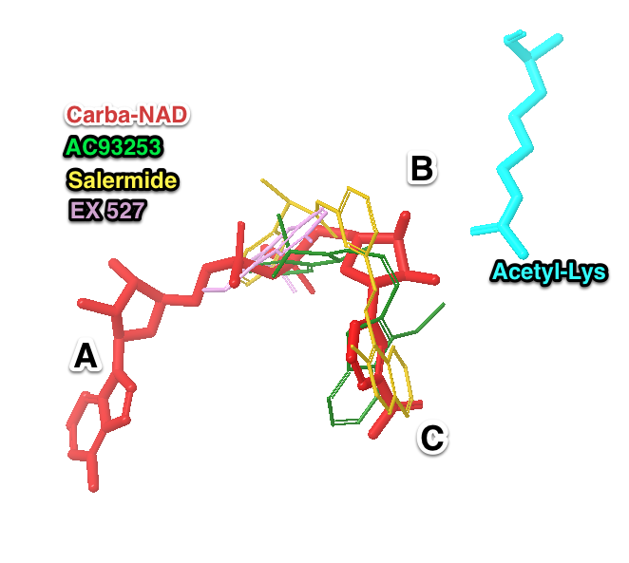
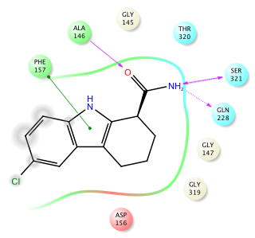
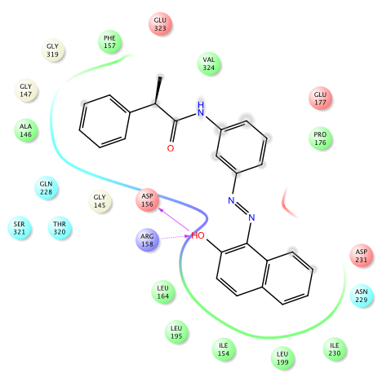
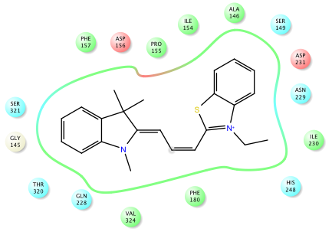
SIRT3 Inhibitors: Docking into 4FVT
EX527
AC93253
Salermide
Notes:
Analysis of the binding poses for the uM potent SIRT3 inhibitors:
They bind in part of the A and the C pockets, not the B pocket.
The most potent inhibitor, AC93253, does not have any H-bond contacts, it makes energetically favorable hydrophobic contacts
The other two, salermide and EX527 make different H-bond contacts.
The red ligand is the co-crystallized Carba-NAD from the 4FVT structure.
In ligand interaction diagrams: green is hydrophobic, red arrows are H-bonds.

Slide 29


SIRT3 Loops and Residues
Largest difference between Sirtuins:
The flexible loop region
Residues near the A, B, and C binding
sites for NAD
Red: Promiscuous residues. SIRT3 4FVT
Blue: Slightly promiscuous.
Notes:
SIRT3 is from PDB 4FVT, which is co-crystallized with Carba-NAD+
Shown zoom of binding pocket A, B, and C in the Sirtuin.
This slide highlights the main differences between SIRT3 and SIRT1.

Slide 30

Comptitive vs. Non-competitive
NAD+ binding
 | MM-GBSA
 | AC | AB
Sir2 | -92.6 | -95.2 | ← Non-competitive
SIRT3 | -107.9 | -84.4 | ← Competitive
Steric clashes between NAD+ in the AB induced fit docked conformation into SIRT3 partially explain the less favorable energy
Cautious interpretation:
Numbers not absolute binding affinity
Difficult to obtain absolute binding affinity with NAD+
Not a cogeneric series
No co-crystallized structure of NAD+ in SIRT3
Notes:
Carefully explain limitations of the MM-GBSA numbers. Direct discussion to the figure, showing the how Sir2 has a more open volume in the B pocket, while SIRT3 does not. Question for me to answer: is the Sir2 crystal structure of NAD+ in AB and AC co-crystallized and the apo structures both support his more open conformation in the B pocket? Could this more open conformation in Sir2 be because the NAD+ AB co-crystallized structure conformed to that AB pose, while the structure available in SIRT3 does not have this accommodation?

Slide 31

Future Direction
Protein expression and purification
  Single mutation
  Site-directed mutagenesis
Base-Exchange assay
  Substrate specific
  Activators and inhibitors
Structure study for binding affinity measurement - by Isothermal Titration Calorimetry
Simulation
Notes:
Cell-based deacetylation assay_ Milne JC, Lambert PD, Schenk S, et al. (2007) Nature 450:712-716.
FEP – free energy perturbation – N/A to screening large database

Slide 32
Acknowledgement
Dr. Clarence E. Schutt (Princeton University)

Slide 33

Mechanism of activation of hSIRT3 deacetylation by isoNAM
Notes:
Isonicotinamide can compete with nicotinamide for binding but cannot initiate the reverse reaction, thereby leading to apparent activation through relief of nicotinamide inhibition (14, 58). Similar findings were observed in current study. The addition of 900uM isonicotinamide decreases the hSIRT3 inhibition by 20% in the presence of 100uM NAM. Structural and further biochemical studies on these compounds and mechanisms might enable the development of isoform selective modulators. Combining computational docking results, a proposed mechanism of activation of hSIRT3 deacetylation by isoNAM is described. IsoNAM has minor inhibition effect of hSIRT3 with IC50 = 13.8 mM. IsoNAM does not compete with NAD+ or acetyl lysine binding to hSIRT3, and it does not react with the imidate. However, isoNAM competitively inhibit NAM-exchange reaction thereby activates hSIRT3 activity by reliefing NAM inhibition. The compound isoNAM is a weak binding to hSIRT3 and only derepresses NAM inhibition at millimolar concentrations. The effect of isoNAM on yeast Sir2 has been reported to enhance gene silencing and correct for deletion of PNC1(56). IsoNAM is relatively non-toxic to mammalian cells, readily penetrates cells, very stable, and highly soluble in water, which make it a suitable starting compound to study with for design of sirtuin activator.

Slide 34


NAD⁺ nonproductive/productive conformations
Avalos JL, Bever KM, Wolberger C (2005) Molecular Cell, 17, 859-868.
Denu, J.M. (2003). Trends Biochem. Sci. 28, 41–48.
Notes:
NAD+ can bind in various “nonproductive” conformations that are not suitable for catalysis. However, simultaneous binding of NAD+ and substrate peptide to the enzyme promotes binding of NAD+ in a distinct “productive” conformation that places the nicotinamide ring in a highly conserved pocket, called the C porcket, where it is activated for catalysis.
In the absence of substrate peptide, NAD⁺ can bind in the A and B pockets of sirtuins in alternative nonporductive conformations
In the presence of substrate peptide, NAD⁺ binds in a precise productive conformation that buries its nicotinamide moiety in the highly conserved C pocket of sirtuins.

Slide 35

Within the C Pocket
Jackson, M.D et al J. Biol. Chem. (2003) 278, 50985–50998.
Sauve, A.A., and Schramm, V.L. Curr. Med. Chem. (2004)11, 807–826.
Notes:
Step i: NAD+ binds in a productive conformation in the C pocket (yellow), making hydrogen bonds with the rigid wall of the pocket (red residues), which promotes NAD+ cleavage (blue arrows). Step ii: The produced O-alkyl amidate intermediate in the extended confor-mation can reform NAD+ with a reactive nicotinamide in the C pocket unless the nicotinamide is entrapped by flipping (pink arrows) or the inter-mediate shifts to a contracted conformation (green arrows). Step iii: The entrapped nicotinamide buries its N1 against residues in the flexible wall of the C pocket (green residues), thereby preventing it from reacting with the O-alky amidate, even if this intermediate is in the extended conformation. From this position, nicotinamide can either flip out of entrapment (pink arrows) or be released by the enzyme (black arrows).

Slide 36

Physiological concentration of nicotinamide in Mammalian tissues
Animal | tissue | [nicotinamide] | Reference | Note
Sheep | Cerebrospinal fluid | 54.2 uM | Anal. Biochem (2002) 301: 21-26. | The entire surface of central nervous system is bathed by a clear, colorless fluid called cerebrospinal fluid (CSF). The CSF is contained within a system of fluid-filled cavities called ventricles. The ventricles are shown in blue on the following midsagittal section of the brain.
Rat | Liver | 26.2 uM 1.6umol/kg | J Bio Chem (1968) 243: 4980-4986.
 | Kidney | 1.0 umol/kg | Science (2004) 305:1010-1013.
 | Brain | 0.4 umol/kg
Mouse | Liver | 10 uM | Am J Clin Nutr (1971) 24: 800-804.

Slide 37



Flexible loop is influenced by NAD+ binding, which can trigger the assembly /disassembly of the C pocket
Sir2Af2 bound to nicotinamide (yellow) and nonproductive NAD⁺ (white) with a highlighted flexible loop (orange).
Sir2Af2 bound to nicotinamide (yellow) and ADP ribose (white) with a highlighted flexible loop (orange).
Sir2Tm bound to nicotinamide (yellow) and acetylated p53 peptide (blue), flexible loop highlighted (orange).
Avalos JL et al (2005) Mol Cell 17: 855-868.
Notes:
Sirtuins contain a highly flexible region, called the flexible loop, which adopts a variety of conformations in different crystal structures and is in some cases partially disordered. This 15-30 amino acid flexible loop includes some of the most highly conserved residues in sirtuins, which form the front wall of the C pocket. Nicotinamide can bind to sirtuins simultaneously with peptide, ADP ribose, or NAD⁺ that is in a nonproductive conformation. These ternary structures show that nicotinamide can bind I a collection of alternative positions that are anchored by the carboxamide group but leave that pyridine ring free to pivot inside the C pocket.

Slide 38












 | Competitive inhibition | Non-competitive inhibition
Equilibria
General Principle | In the presence of competitive inhibitor, the V_{max} remains unchanged but the apparent K_{m} for the substrate increased. Increase in the K_{m} does not mean that the EI complex has a lower affinity for the substrate. The EI has no affinity at all for the S, while affinity for E is unchanged. The apparent increase in the K_{m} results from a distribution of available enzyme between the “full affinity” and “no affinity” forms. | In the presence of noncompetitive inhibitor, the V_{max}, decreases but has no effect on the K_{m} value. The degree of inhibition in the presence of a non-competitive inhibitor depends only upon [I] and K_{i}. The inhibited velocity (vi) is always a constant fraction of v₀, regardless of the substrate concentration or the value of K_{m}. An increase in [S] causes both v₀ and vi to increase by the same factor.
Equations
v vs. [S]
1/v vs. 1/[S]

Slide 39

Sequence Alignment
Example of sequence alignment showing which residues are a part of the flexible loop (will highlight orange), which contact NAM (will highlight yellow), which are conserved (green) and highly conserved residues (red). The above is from the paper “Crystal Structures of Human SIRT3 Displaying Substrate-induced Conformational Changes” It will take some time to taylor the figure for our presentation. Want to make sure this is what we want before I do it.
Notes:
Sirtuins contain a highly flexible region, called the flexible loop. This 15-30 amino acid flexible loop includes some of the most highly conserved residues in sirtuins, which form the front wall of the C pocket. The C pocket is a largely hydrophobic cavity that contains the most highly conserved residues in the catalytic core of sirtuins.

