Slide 1
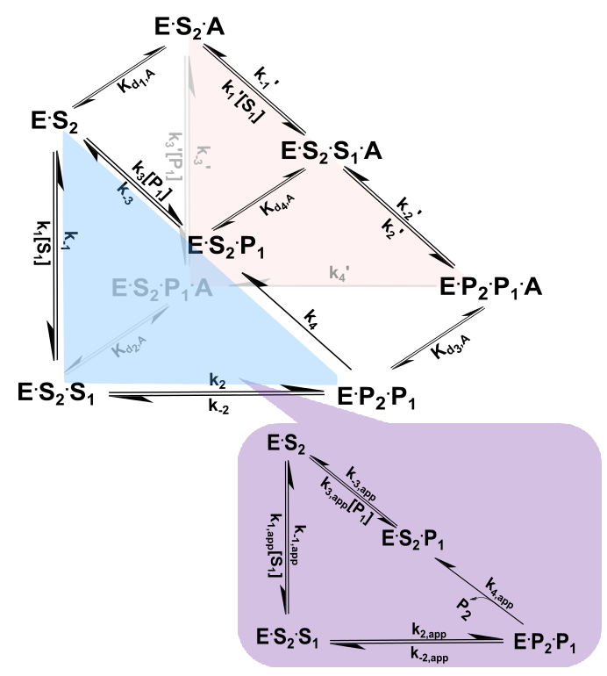
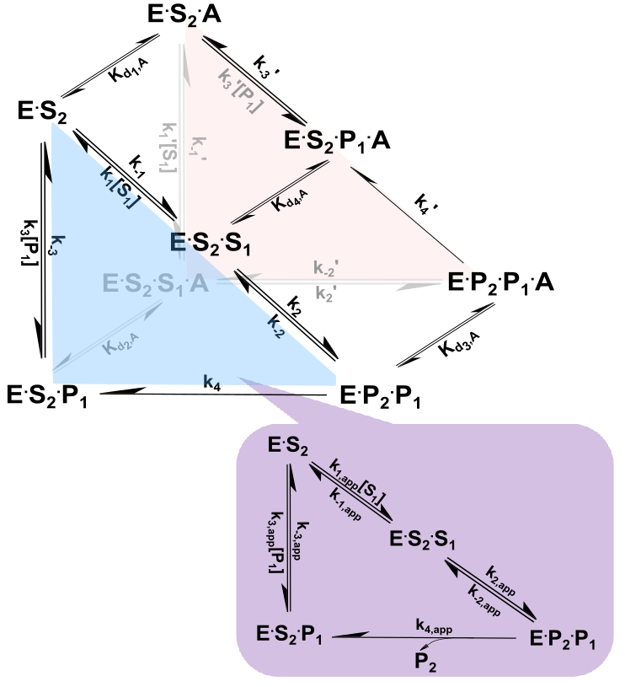
3D Triangle
RC: ---3d (like cube) figure for the triangle. Here, only the mixed noncomp brackets / annotations used in the cube fig apply (no hyperbolic bracket). Brackets would be on the left side and diagonal. Please present in same format as cube---with the app “inset” as well.
Version A
Version B

