Slide 1
2XE0 Expt.
[MnSOD K122] = 600 uM
[NAD+] = 100 uM
[NAM] = 200 uM
Time points = 0, 10, 30, 40, 80, 120 min
AE-Sirt3 = 5 U and 10U (XG Batch I)
No repeat
Raw Data
100uM NAD⁺, 600uM K122, 200uM NAM
Time (min) | 5U/rxn | 10U/rxn
0 | 0.0000 | 0.0000
10 | 0.839 | 1.209
30 | 1.575 | 2.629
40 | 2.157 | 3.250
80 | 3.588 | 5.949
120 | 4.888 | 7.929
Initial rate, uM/min
 | 100uM NAD⁺, 600uM K122, 200uM NAM |  | Ratio
 | 5U/rxn | 10U/rxn
Single Exponentional (include 0min) | 0.05521 | 0.08953 | 1.62
Single Exponentional (omit 0min) | 0.04582 | 0.07976 | 1.74
Double Exponentional | 0.04567 | 0.07949 | 1.74

Slide 2
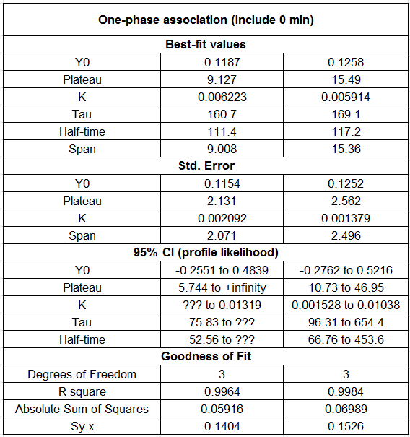
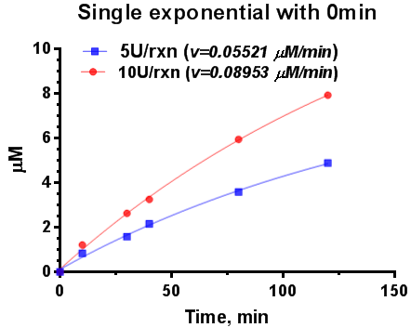

Slide 3
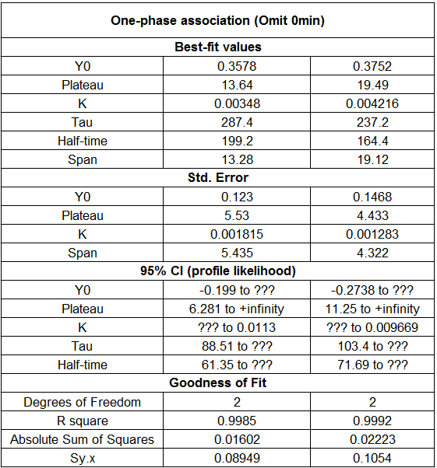
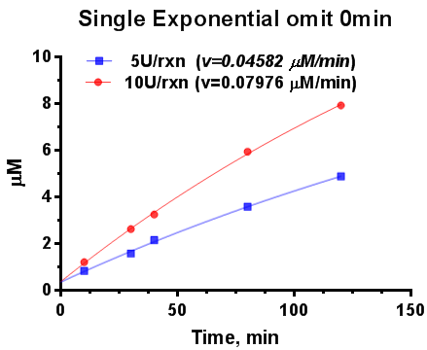

Slide 4
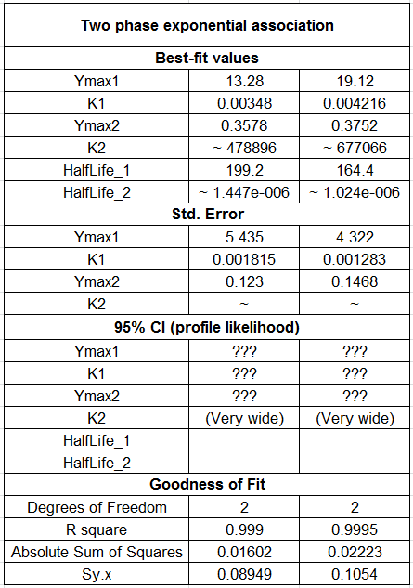
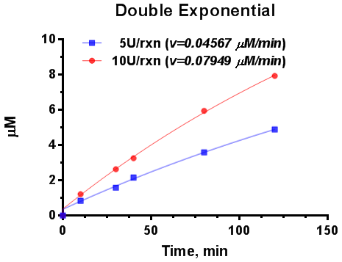

Slide 5
Remarks
Using single exponential function, time series data were fitted with and without 0min. The initials rate obtained from the data set including 0min are higher than those from the data set omitting 0min.
The initial rates fitted by double exponential function are very close to those fitted by single exponential without 0min.
For all the cases, the initial rate using 10U enzyme is 1.74-fold of those using 5 U enzyme.

