Slide 1
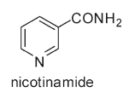
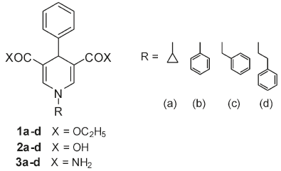
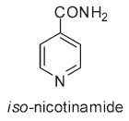
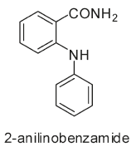
Mai A, et al. Study of 1,4-Dihydropyridine Structural Scaffold: Discovery of Novel Sirtuin Activators and Inhibitors. (2009) J. Med. Chem. 52: 5496-5504.
Product inhibitor
SIRT activator
SIRT1 inhibitor
Notes:
3,5-dicarbethoxy-4-phenyl-1,4-dihydropyridines

Slide 2
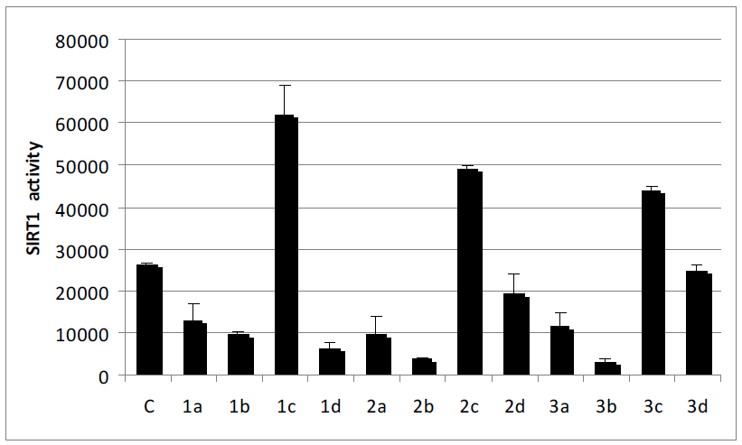
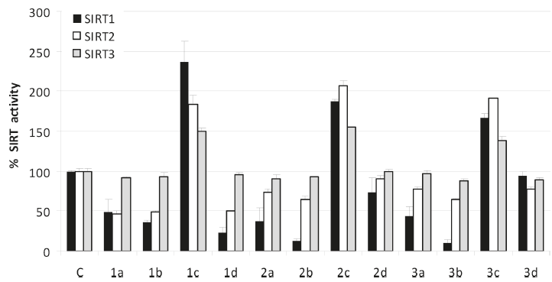
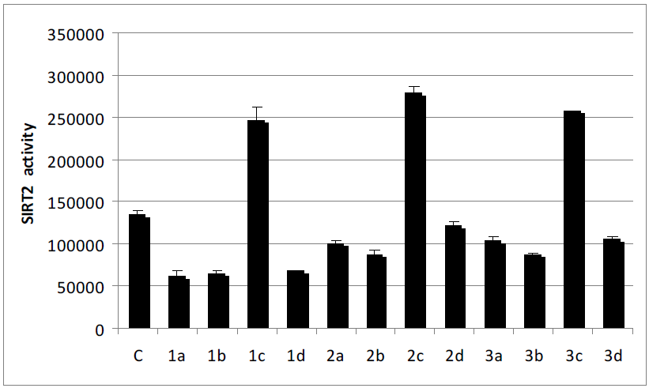
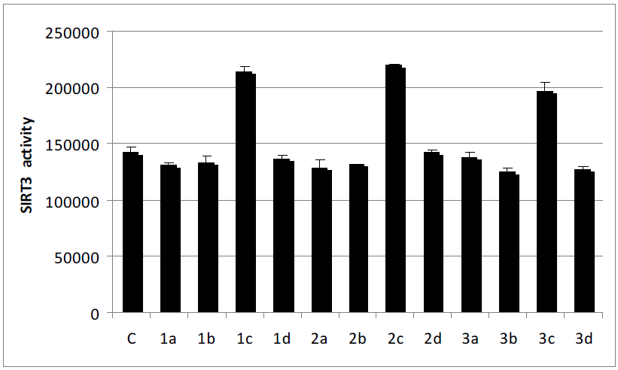
F_{o}=Absolute value of SIRT1/2/3 control
F_{n}=Absolute value of SIRT1/2/3 activity with modulator
% SIRT activity= 100 *F_{n}/F_{o}
Positive control
Figure 2. SIRT1, -2, and -3 modulating activities of compounds 1-3 tested at 50 μM.
Experimental condition:
Fluor de Lys fluorescent biochemical assay
While there is variability in activity among individual lots, each experiment normalizes SIRT1 activity to 1U/reaction well and SIRT2 and SIRT3 activity to 5U/reaction well.
500 μM NAD⁺, 250 μM fluorgenic deacetylase substrate and the compound of interest at a given concentration in a total reaction volume of 50 μL.
An hour incubation at 37ºC
50 uL 1x Developer and the reaction is incubated at 37ºC for an additional 15 min and then read on the plate reader.
Positive controls: enzyme, substrate, NAD⁺, and DMSO.
Background controls: substrate, NAD⁺, and DMSO.
Auto-fluorescent controls: substrate, NAD⁺, and the compound at the same concentration as its experimental counterpart.
Figure S1. Absolute Values of Modulation of SIRT1, -2, and -3 Activities by 1-3.

