Slide 1
To determine if the [dNTP] range finalised during discussion (2-2000μM) will give meaningful data; a test run was performed under following conditions:
Template conc: 200nM Taq Polymerase concentration: 0.36nM
Assay temperature: 60ºC Equilibration: yes:30mins
Time points: 0, 0.5, 0.66, 0.83, 1, 2, 3.5, 5, 6.5, 8.5, 10mins
Only the 0min reactions had a simultaneous - taq reaction.
All reactions prepared from the same master mix of annealed template-primer. 3 replicates of each time point.
 |  | dNTP concentration (μM)
 | Mins | 2.00 |  |  | 20.00 |  |  | 100.00 |  |  | 200.00 |  |  | 1000.00 |  |  | 2000.00
 |  | Rep 1 | Rep 2 | Rep 3 | Rep 1 | Rep 2 | Rep 3 | Rep 1 | Rep 2 | Rep 3 | Rep 1 | Rep 2 | Rep 3 | Rep 1 | Rep 2 | Rep 3 | Rep 1 | Rep 2 | Rep 3
 | 10.00 | 10.00 | 10.42 | 10.45 | 14.45 | 15.51 | 15.36 | 16.14 | 17.28 | 15.79 | 15.87 | 18.17 | 17.20 | 10.98 | 14.38 | 13.72 | 13.00 | 13.25 | 14.03
 | 8.50 | 11.59 | 12.08 | 12.03 | 14.31 | 14.12 | 14.04 | 17.33 | 16.07 | 16.12 | 15.82 | 17.12 | 17.49 | 12.47 | 12.93 | 14.03 | 12.47 | 12.77 | 13.19
 | 6.50 | 9.38 | 9.38 | 10.73 | 12.57 | 13.99 | 13.87 | 13.57 | 14.88 | 15.31 | 13.26 | 15.93 | 14.11 | 11.44 | 11.83 | 12.73 | 10.92 | 12.02 | 12.43
 | 5.00 | 10.05 | 10.86 | 11.17 | 12.48 | 12.45 | 12.79 | 13.41 | 12.58 | 13.33 | 12.75 | 14.02 | 14.57 | 10.38 | 11.45 | 11.72 | 10.76 | 10.92 | 11.03
 | 3.50 | 8.18 | 10.04 | 9.38 | 11.65 | 13.49 | 13.58 | 12.84 | 13.53 | 13.34 | 10.61 | 14.43 | 13.78 | 10.98 | 11.76 | 11.74 | 11.17 | 12.11 | 12.64
 | 2.00 | 7.36 | 8.50 | 8.45 | 10.35 | 10.45 | 10.18 | 10.27 | 10.20 | 11.17 | 9.76 | 11.73 | 12.02 | 9.98 | 10.64 | 11.11 | 10.21 | 9.82 | 10.02
 | 1.00 | 10.13 | 10.71 | 10.06 | 11.99 | 13.41 | 13.43 | 12.70 | 12.83 | 12.60 | 11.01 | 12.95 | 13.33 | 11.61 | 12.41 | 12.83 | 9.76 | 11.72 | 12.63
 | 0.83 | 8.32 | 10.24 | 10.27 | 10.64 | 10.70 | 10.89 | 9.90 | 9.20 | 10.94 | 10.23 | 9.67 | 11.67 | 10.50 | 11.02 | 11.00 | 10.38 | 10.53 | 10.54
 | 0.66 | 8.37 | 9.99 | 11.16 | 11.84 | 12.65 | 14.18 | 12.44 | 12.69 | 12.31 | 10.50 | 12.75 | 13.12 | 11.34 | 12.31 | 13.19 | 11.48 | 12.89 | 12.46
 | 0.50 | 9.15 | 10.69 | 10.96 | 10.71 | 11.28 | 11.30 | 10.38 | 11.03 | 11.24 | 10.26 | 11.43 | 11.94 | 10.94 | 11.00 | 9.87 | 10.36 | 10.52 | 11.14
+taq | 0.00 | 9.39 | 8.93 | 8.77 | 10.24 | 12.16 | 11.78 | 9.94 | 11.53 | 10.86 | 10.39 | 11.56 | 11.25 | 10.60 | 11.54 | 12.27 | 11.18 | 12.20 | 11.92
-taq | 0.00 | 7.39 | 9.34 | 9.65 | 10.53 | 10.68 | 11.47 | 9.47 | 9.01 | 9.22 | 9.35 | 10.58 | 10.26 | 10.72 | 10.68 | 11.69 | 12.43 | 10.91 | 11.69

Slide 2
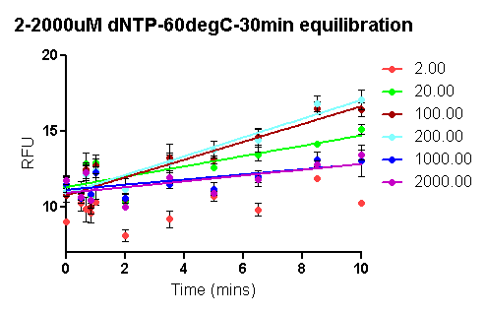
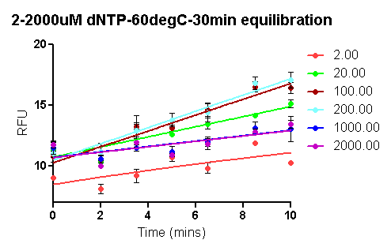
Comparison of Taq Pol Assay (60ºC) at dNTP conc 2-2000μM: see following slides for individual plots; the table represents Prism data
Plot I
Plot II
 |  |  |  | 2 | 20 | 100 | 200 | 1000 | 2000 | uM dNTP
Time points: 0, 0.5, 0.66, 0.83, 1, 2, 3.5, 5, 6.5, 8.5, 10mins Plot I |  |  | R square |  | 0.5592 | 0.794 | 0.7617
 |  |  | One-phase assn fit | Not converged | Ambiguous | Ambiguous | Ambiguous | Interrupted | Interrupted
Time points: 0, 2, 3.5, 5, 6.5, 8.5, 10mins Plot II |  |  | R square | 0.4699 | 0.7342 | 0.8724 | 0.7975 |  | 0.4212
 |  |  | One-phase assn fit |  | Ambiguous | Ambiguous | Ambiguous | Interrupted | Ambiguous

Slide 3
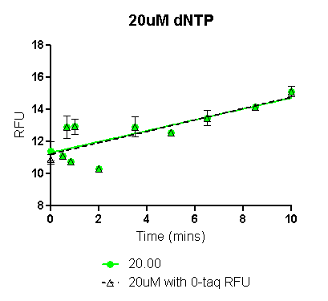
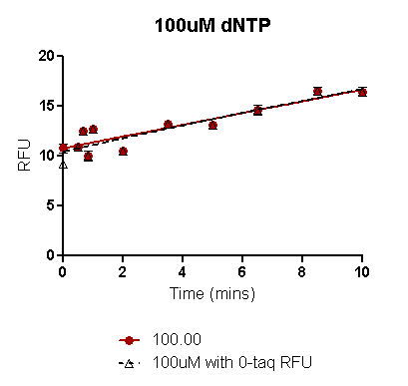
The only - taq control run along with the reactions in this test run was the 0min - taq rxn.
For 20, 100 and 200 μM [dNTP] conc, the plots were constructed in Prism using all +taq RFUs with 0min +taq RFU (solid line green for 20μM and brown for 100μM in the plots above) and also with 0min –taq RFU (black dashed line in both plots). The comparison shows that there is no difference in the plots, thus the 0min +taq RFU may be used for calculations. See following table for comparison of R square values:
Rsquare values comparison for plot construction using 0min +taq RFUs with 0min -taq RFUs
 |  |  | 2 | 20 | 100 | 200 | 1000 | 2000 | uM dNTP
 |  | 0min +taq | ND | 0.5592 | 0.794 | 0.761 | ND | ND
 |  | 0min -taq |  | 0.5877 | 0.796 | 0.772

Slide 4
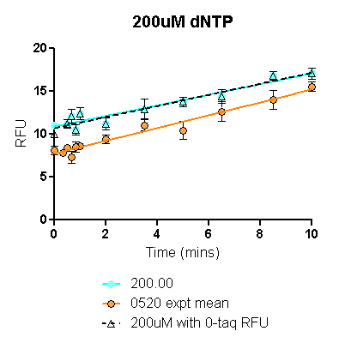
The solid cyan line and the dashed black line represent plots made with 0min +taq RFU and 0min –taq RFU as explained in the previous slide. Again the 2 plots overlap. (Also see table for raw data).
The orange line represents the data from the previous expt when the same assay was repeated 3X to test reproducibility, although overall RFUs are lower, the initial rate calculated from both Prism fitted curves are similar (see table below):
Comparison of 200uM [dNTP] assay with the previous (0519-20-21) 200uM [dNTP] assay
 |  |  | 60613 | 52013
 |  | R square | 0.7617 | 0.8358
 | Initial rate calc from fitted curve |  | 0.83 | 0.83

Slide 5
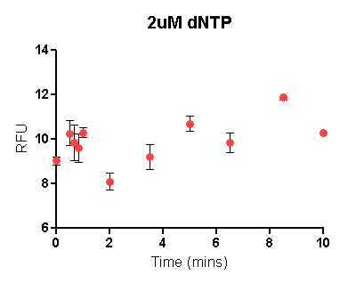
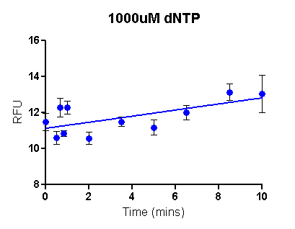
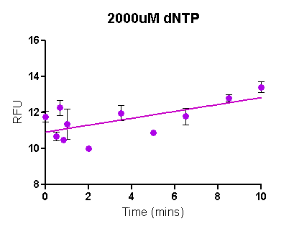
2uM is the lower extreme; 1000 and 2000uM are the higher extremes of [dNTP] considered in this test run. The prism software is unable to fit the 2uM [dNTP] data even without the early time points.
For 1000 and 2000uM [dNTP], the software draws a curve but the fit is ambigious or interrupted and it is not able to assign an R square value (see Table on slide 1 for details).

