Slide 1
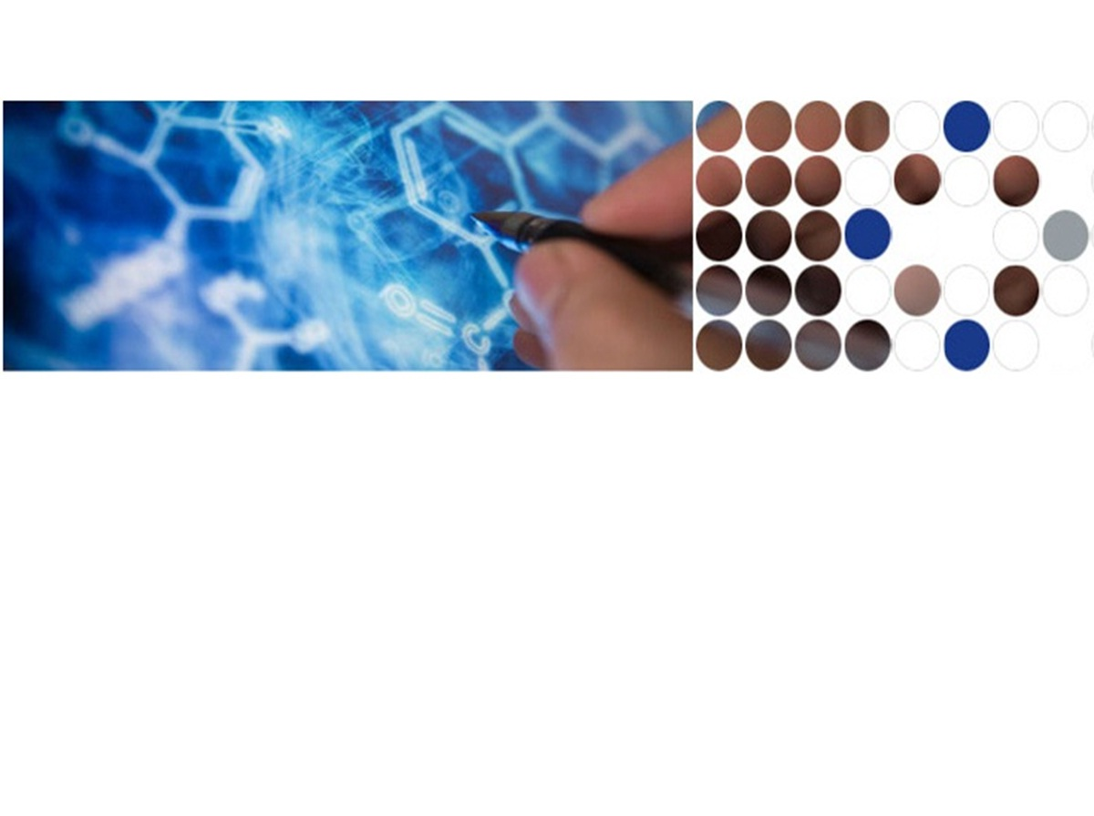
Mechanism of Human SIRT3 Inhibition
Xiangying Guan, PhD
Eric Knoll, PhD*
Raj Chakrabarti, PhD**
PMC Advanced Technology, LLC
* CMU collaboration
** Carnegie Mellon University

Slide 2
Outline
Background
Aging, Sirtuins
Importance of SIRT3
Target novel inhibitor of SIRT3
Inhibition modes
Mechanism of Sirtuin Deacetylation Reaction
Methods
Results from Wet Lab
Mechanism for hSIRT1, hSIRT3
Inhibitors
Computer Simulations: mechanism and virtual screening
Future Direction

Slide 3





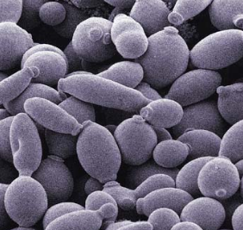
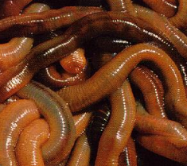
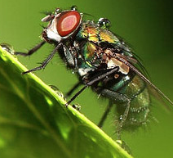
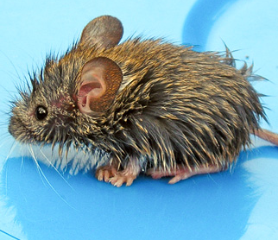
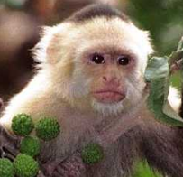

Live longer? Healthier?
Silent Information Regulator 2 (Sir2) was first identified in yeast as a lifespan regulator. Since then, many members of this family have been identified in species ranging from yeast to human .
Yeast Worms fly mouse monkey human
Tissenbaum HA, and Guarente L. Nature (2001)410, 227-230.
Rogina B, Helfand SL. PNAS (2004) 101, 15998-16003.
Herranz D, Munoz-Martin M, et al. Nat Commun (2010) 1, 3.
United Nations Department of Economic and Social Affairs, Population Division. World Population Prospects. The 2010 Revision, New York, United Nations, 2011.
Notes:
Between 2000 and 2050, the proportion of the world's population over 60 years will double from about 11% to 22%. The absolute number of people aged 60 years and over is expected to increase from 605 million to 2 billion over the same period. Every 7 seconds in the united state, someone turns 60.

Slide 4
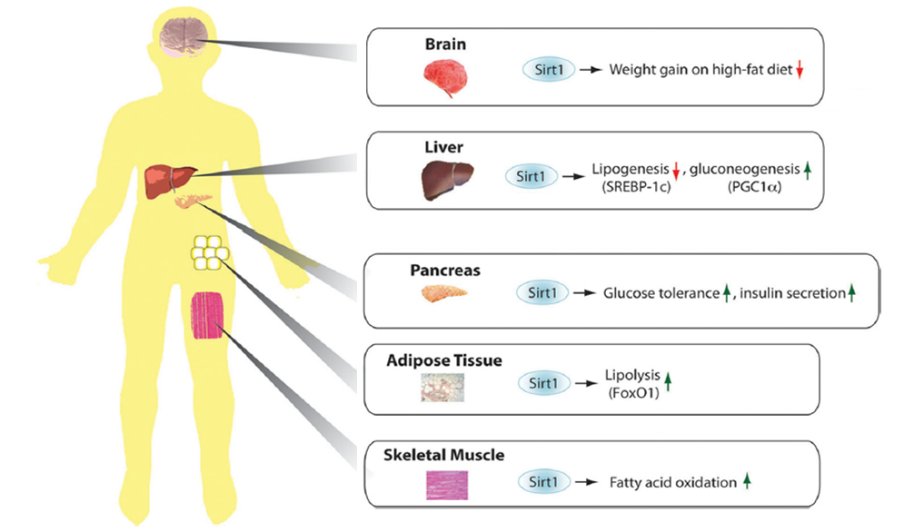
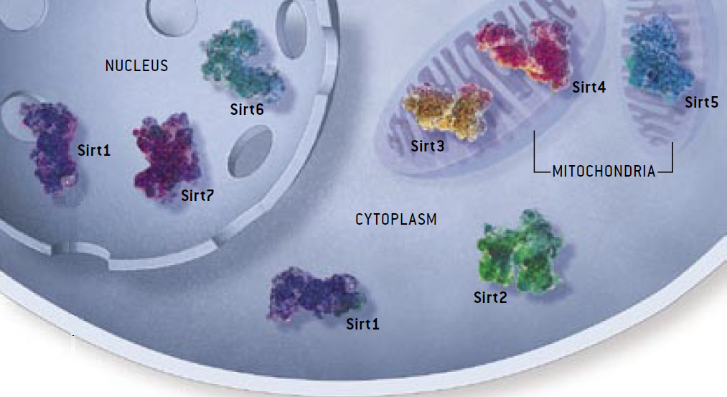
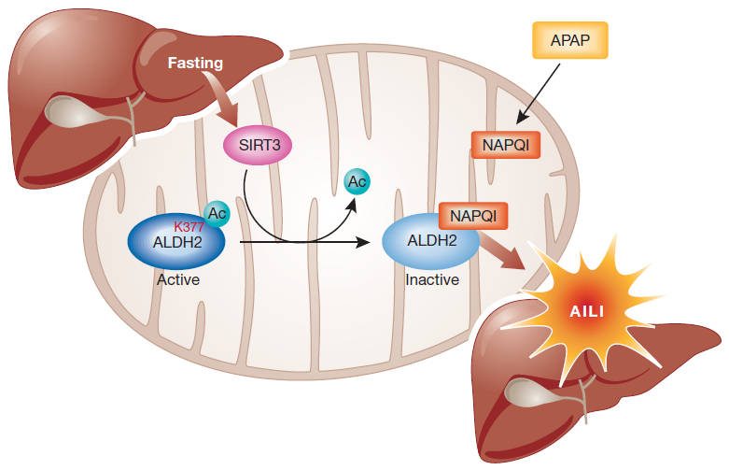
Sirtuin Family
Understanding the inhibition mechanism
Design for
Selectivity
Affinity
Activation / Inhibition
Only SIRT3 has been reported to be associated with an extended lifespan of man by regulating its expression.
Increased level of SIRT3 associated with node-positive breast cancer; oral squamlors cell carcinoma; as well as acetaminophen-induced liver injury.
Sinclair, DA and Guarente L (2006) Scientific American 48-57.
Frye, R.A. (2000) Biochemical and Biophysical Research Communications, 273, 793–798.
Alhazzazi TY et al. (2011) Biochim Biophy Acta. 1816, 80-88.
Lu Z et al (2011) EMBO Rep 12:840-846.
Notes:
There are seven human sirtuins, SIRT1–7 with diverse subcellular localization. SIRT1, SIRT6, and SIRT7 are nuclear proteins. SIRT1 can also shuttle between cytosol and the nucleoplasm. SIRT3, SIRT4, and SIRT5 are found in mitochondria, and SIRT2 is primarily in cytoplasm.
The Sirt1 enzyme is the best characterized Sirtuin, deacetylating other proteins and thereby altering their behavior. Metabolic functions of mamalian sirtuins in different tissues. Brain, Liver, Pancreas, Adipose Tissue, Skeletal muscles.
Among these 7 sirtuins, only SIRT3 has been reported to be associated with an extended lifespan of man by regulating its expression. Increasing SIRT3 activity will promote breast cancer, oral cancer and direct liver injury. Understanding the properties of the inhibitory mechanism will give support to the elucidation of the mechanism of SIRT3 mediated deacetylation and allow improvements in inhibitor selectivity and affinity. In this way, its inhibitors are of interest not only as tools for elucidating in detail the biological functions of the enzyme, but also as potential therapeutic agents.
This talk is mainly focus on the mechanism and on design inhibitors. Both activation and inhibition could be therapeutic target depending on the diseases.
4

Slide 5



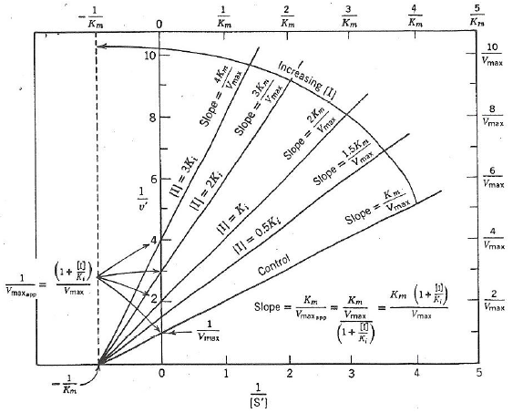
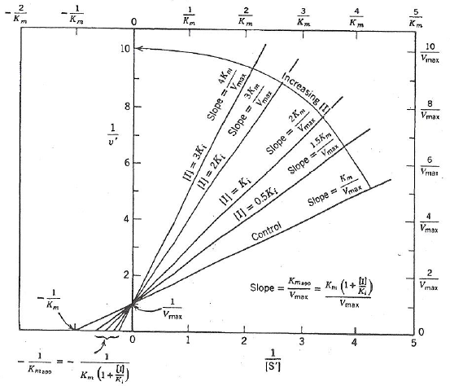
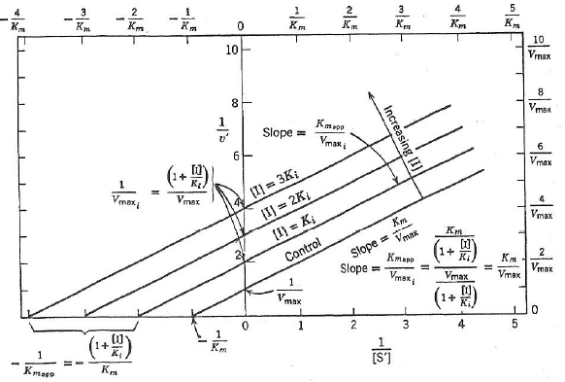
Reversible modes of inhibitor interactions with enzymes
Uncompetitive Inhibition
Competitive Inhibition
Noncompetitive Inhibition
S
S
S
S
S
S
E
E
ES
ES
E
ES
I
I
I
I
I
S
S
S
I
I
I
EI
EI
ESI
ESI
Segel IH. Enzyme kinetics. (1993) John Wiley & Sons, Inc., Hoboken, New Jersey.
Copeland RA. Evaluation of enzyme inhibitors in drug discovery (2005) John Wiley & Sons, Inc., Hoboken, New Jersey.
Notes:
Most drugs bind to their enzyme target through reversible interactions. Three potential modes of inhibitor interactions with enzymes. An inhibitor that binds exclusively to the free enzyme is called competitive inhibitor, these inhibitors compete with substrate for the pool of free enzyme molecules. A noncompetitive inhibitor is one that displays binding affinity for both the free enzyme and the enzyme-substrate complex or subsequent species. A uncompetitive inhibitor is one that binds exclusively to the ES complex, or a subsequent species, with little or no affinity for the free enzyme.

Slide 6
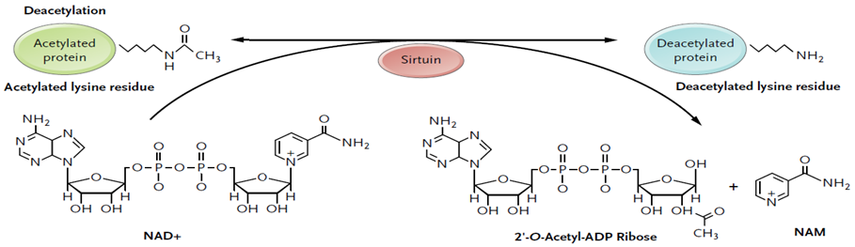
Sir2 NAD⁺-dependent deacetylation chemistry
MS, HPLC for quantitatively measurement of one or more product;
Radioactive Assay ([³H]- or [¹⁴C]- labeled acetyl groups in the moiety of the peptide) for
scintillation counting;
NAD⁺ bioluminescence assay;
Fluorimetric Assay
Experimental Assay Computational Simulation
BIOMOL Assay Induced Fit Docking
PNC1/GDH Assay Binding Affinity (MM-GBSA)
Michan S and Sinclair D(2007) Sirtuins in mammals: insights into their biological function. Biochem J 404, 1-13.
Haigis MC (2006) Mammalian sirtuins-emerging roles in physiology, aging, and calorie restriction. Genes Dev 20, 2913-2921
Notes:
The Sir2 utilize a unique catalytic mechanism that consumes NAD⁺, providing a direct connection between protein deacetylation and central metabolic pathways. The use of NAD as a co-substrate distinguishes sirtuins from other classes of protein deacetylases. The majority of sirtuin proteins function to catalyze the NAD-dependent deacetylation of acetylated lysine residues. However this function has not been demonstrated for all sirtuins. SIRT4 was reported to function as an ADP-ribosyl transferase protein. And the molecular function of nuclear SIRT7 is not well established.
Sirtuins catalyze the NAD⁺-dependent deacetylation of acetylated lysine residues, and produce deacetylated lysine, nicotinamide, and 2’OAADP ribose.
Interestingly, one of the reaction products, Nicotinamide, is the physiological inhibitor of yeast Sir2, human SIRT1 and SIRT2. However, no studies of nicotinamide inhibition of human SIRT3 have been done yet. The focus of the work described here is to identify the critical roles of NAM and its analogue responsible to modulate the human SIRT3 activity. This is the foundation of virtual screening drug candidate for future work.
Many methods have been applied to study sirtuin kinetics. Including, 1) using Mass Spec, High Pressure Liquid Chromatography (HPLC) to measure one or more product; 2) Radioactive assay; 3) bioluminescence assay; and 4) fluorescence-based assay. Here, we are using BIOMOL assay and PNC1/GDH assay combined with Induced fit protein-ligand docking and molecular mechanics /generalized born surface area (MM/GBSA) calculations to study how NAM inhibits human SIRT3 deacetylase activity. By understanding the mechanism, we further tested few potent hSIRT3 inhibitor for potential therapeutic use of Sirtuin-based therapies for the treatment of human diseases.

Slide 7
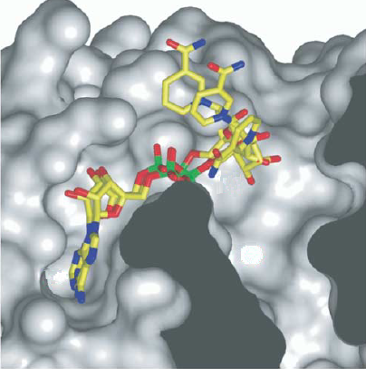
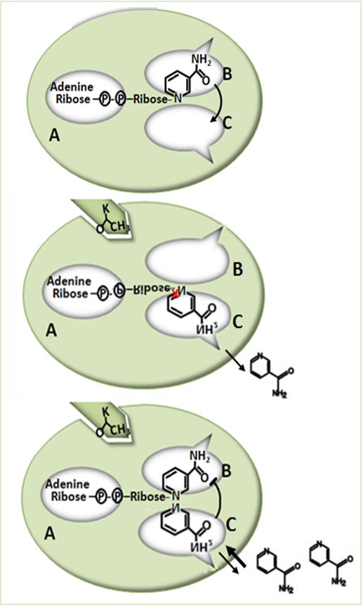
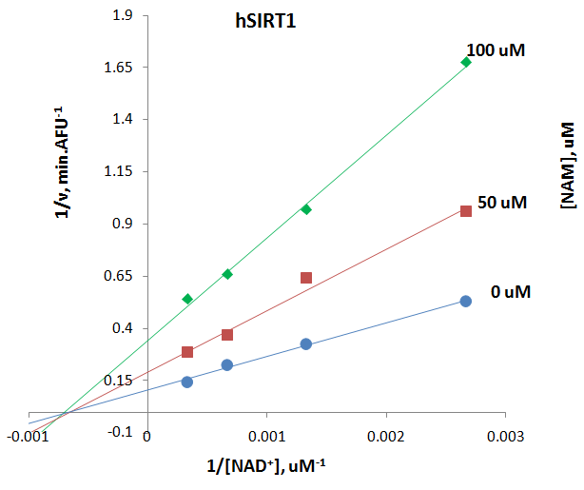
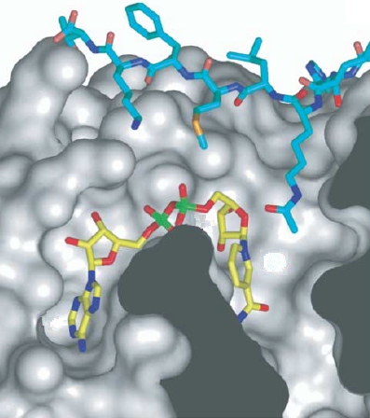

NAM noncompetitively inhibits hSIRT1
NAD⁺
In the absence of substrate peptide, NAD+ can bind in the A and B pockets of Sir2
B
C
A
In the presence of a substrate peptide, NAD+ binds in a precise productive conformation that buries its nicotinamide moiety in the highly conserved C pocket of Sir2
NAD⁺
B
A
C
J Bio Chem (2002) 277:45099-45107.
Mol. Cell (2005) 17: 855-868.
Notes:
By using aforementioned assay, we have studied the NAM inhibition effect on human SIRT1. Our results indicate that NAM noncompetitively inhibit human SIRT1, which fall in good agreement with reported work done by Dr. Sinclair’s group at Harvard University. Similarly, it was found that NAM is a noncompetitive inhibitor for yeast Sir2.
The Sir2 enzyme structure study from Dr. Wolberger’s group at Johns Hopkins University revealed that in the absence of substrate peptide, NAD can bind in the A and B pocket of Sir2. In the presence of a substrate peptide, NAD binds in a precise productive conformation that buries its NAM moiety in the highly conserved C pocket of Sir2. (Space-filling model of Sir2-Af2 and nicotinamide inhibition.)
The structure basis of Sir2 function reveal that the Sir2 family of deacetylases contains an NAD binding pocket divided into three distinct regions. The adenine-ribose moiety of NAD binds the A site whereas, in the absence of acetylated substrate, the nicotinamide moiety is bound to the B site.
B, in the presence of an acetyllysine (K) a rotation around a phosphodiester bond of the pyrophosphate moiety would position the nicotinamide group near the C site where hydrolysis and subsequent nicotinamide release may take place.
C, when present at elevated levels, free nicotinamide may bind to the C site preventing the conformational change and hydrolysis of NAD. Inhibition by NAM is proposed to occur when free NAM binds in the C-pocket and reacts with the relatively long-lived peptidyl intermediate, driving the reaction in reverse to generate NAD+ and acetylated target protein.
In the presence of an acetyllysine, NAD bound to the B site can undergo a conformational change bringing the nicotinamide group in proximity to the C site, where it may be cleaved. The ADP-ribose product of this reaction may then return to the B site where deacetylation of the acetyllysine occurs. We propose that nicotinamide binds to and blocks the internal C site, preventing the conformational change and subsequent cleavage of NAD.

Slide 8
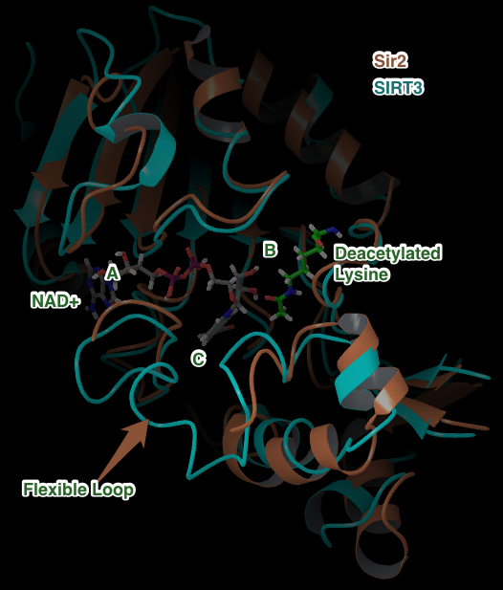
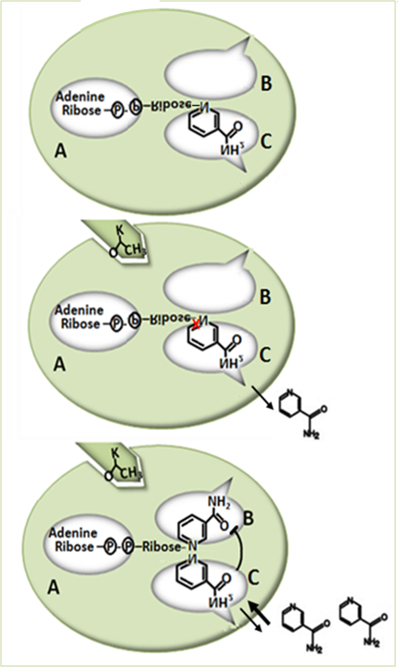
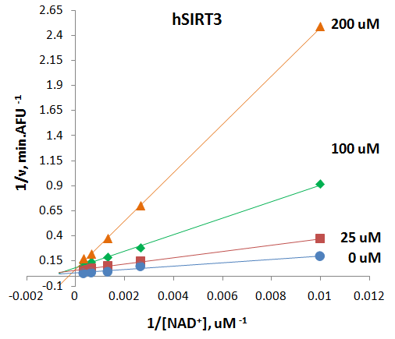

NAM competitively inhibits hSIRT3
MM-GBSA
 | AC | AB
Sir2 | -92.6 | -95.2 | ← Non-competitive
SIRT3 | -107.9 | -84.4 | ← Competitive
?
Notes:
However, NAM behave differently on human SIRT3. Our results indicate that NAM competitively inhibit human SIRT3. A group from GSK company-Sirtris found the similar inhibition effect on mouse SIRT3.
The computational simulation work have been done on the cluster at Carnegie Mellon University, where we got collaboration with. Our scientist docked NAD+ into AB pocket vs. AC pocket of human SIRT3 and the MMGBSA scores were calculated. The results show that steric clashes between NAD+ in the AB induced fit docked conformation into SIRT3 partially explain the less favorable energy.
Therefore, we propose, here, that the adenine-ribose moiety of NAD binds the A site whereas, in the absence of acetylated substrate, the nicotinamide moiety is energetically favored to bound to the C site. B, in the presence of an acetyllysine (K) hydrolysis and subsequent nicotinamide release may take place. C, when present at elevated levels, free nicotinamide may compete with NAD for C binding site.

Slide 9
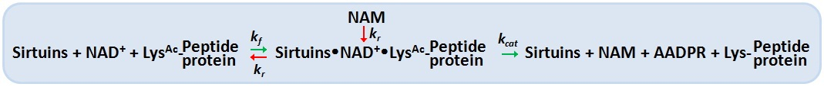
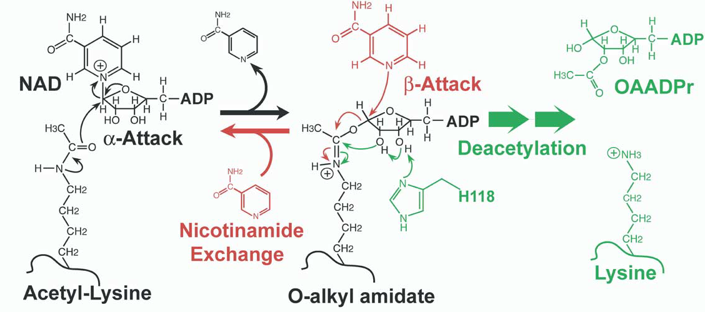
Mechanism of Sir2/SIRT1 inhibition by NAM
Nicotinamide can react with the intermediate in a process known as nicotinamide exchange, in which NAD⁺ and acetyl-lysine are reforemed.
Denu JM (2003) Trends Biochem. Sci. 28: 41 - 48.
Sauve AA et al (2001) Biochemistry 40: 15456 – 15463.
Sauve AA et al (2003) Biochemistry 42: 9249 – 9256.
Sauve AA et al (2004) Curr. Med. Chem. 11: 807 – 826.
Jackson MD et al (2003) 278: 50985 – 50998.
Notes:
Nicotinamide is a potent inhibitor of the Sir2 reaction because of its ability to rebind with the enzyme and react with a high-energy intermediate, preventing deacetylation and regenerating starting materials. Few groups have been reported that NAM can react to regenerate acetyllysine and NAD⁺ in a nicotinamide exchange reaction, in which the imidate intermediate is emptied during normal steady-state turnover, directing NAM inhibition of deacetylation.
The reactivity between Base Exchange and deacetylation reactions occurs when NAM is around. This competition partitions the intermediate forward and backward to provide inhibition of deacetylation. The independence of the deacetylation and base exchange reactions establishes that base exchange is a b-face nucleophile process, whereas deacetylation is an a-face nucleophilic process.NAM partition ratios are controlled by the relative rates of nucleophilic chemistry at the b-face versus the a-face of the intermediate. The exchange and deacetylation reactions share the intermediate forming step, and the ratio is determined by the chemical processes.

Slide 10
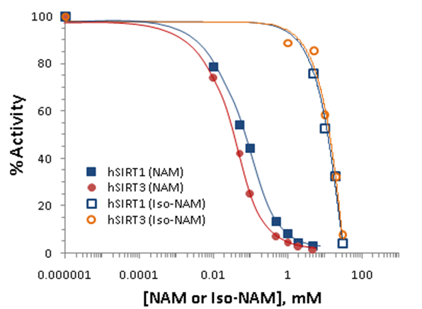
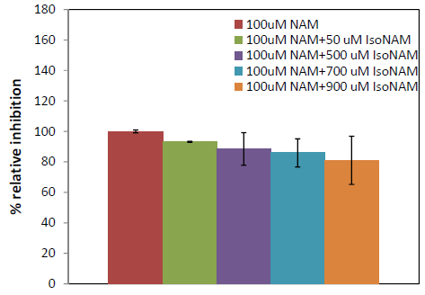
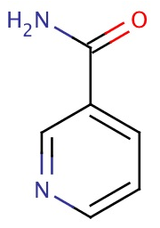
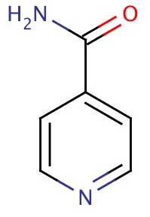

IsoNAM is a weak inhibitor for SIRT1/SIRT3
NAM
IsoNAM competitively inhibit NAM-exchange reaction thereby activates hSIRT3 activity by relieving NAM inhibition.
Iso-NAM
Notes:
Nicotinamide inhibition assays showing percent change in deacetylation activity as a function of nicotinamide concentration. Data for the hSIRT1 enzyme are indicated with close square and a blue curve; data for the hSIRT3 are indicated with filled circles and a red line.
IsoNAM is a weak inhibitor for both SIRT1 and SIRT3.
A NAM analogue, isonicotinamide (isoNAM), that competes for free NAM binding but does not react appreciably with the enzyme intermediate, increases the Sir2 activity
IsoNAM does not compete with NAD+ or acetyl lysine binding to hSIRT3, and it does not react with the imidate. However, isoNAM competitively inhibit NAM-exchange reaction thereby activates hSIRT3 activity by reliefing NAM inhibition. The compound isoNAM is a weak binding to hSIRT3 and only derepresses NAM inhibition at millimolar concentrations. The effect of isoNAM on yeast Sir2 has been reported to enhance gene silencing and correct for deletion of PNC1(56). IsoNAM is relatively non-toxic to mammalian cells, readily penetrates cells, very stable, and highly soluble in water, which make it a suitable starting compound to study with for design of sirtuin activator

Slide 11
Simulation Methods
Objectives:
Elucidate competitive vs. non-competitive mechanisms
Design and virtually screen inhibitors
How:
Protein-ligand docking with GlideXP and Induced Fit Docking
  Poses and intermolecular contacts replicated for available co-crystallized structures in Sir2, SIRT1, SIRT2, SIRT3.
MM-GBSA and LIA
  More accurate binding affinity predictions than docking score

Slide 12
Computational Methods: ∆G_{bind}
Standard docking with Glide
  Heuristic docking score optimized for finding correct ligand pose rather than correlation to absolute ∆G_{bind}
MM-GBSA
  ∆G_{bind} = ∆E_{MM} - ∆G_{SOLV} + ∆G_{SA}
  Improve by linear regression to experiment
  Best case scenario R² ~ 0.8, typical R²~0.3
  Benefits: fast, so can scan huge library, better than docking score alone
  Limitations: Does not include entropy, ligand or protein reorganization energy, explicit waters, etc.
Notes:
Protocol for protein preparation:
All proteins were prepared with the Protein preparation tool from Schrodinger.
Protocol for Glide:

Slide 13
Computational Methods: ∆G_{bind}
Induced Fit + MM-GBSA
  Improves docking by allowing for receptor side chain and backbone flexibility, but may add noise
LIA (linear interaction approximation)
  ΔG = α (<U^{b}_{vdw}> – <U^{f}_{vdw} >) + β (<U^{b}_{elec} > -<U^{f}_{elec}>) +
  γ (<U^{b}_{cav}> – <U^{f}_{cav}>)
  A linear response method (LRM) similar to LIE.
  Multiple linear regression (3 terms) fitted to at least 5 experimental ∆G_{bind}

Slide 14
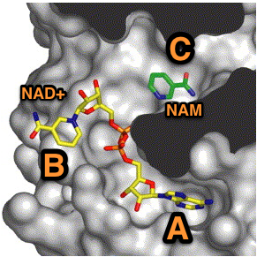
SIRT3 structure
⬆Sir2 showing A, B, C binding pockets. (image from C. Wolberger, Johns Hopkins Medical School)
⬅Superposition of SIRT3 with Sir2
Notes:
Verify RMSD between SIRT3 and Sir2….
Add details on discussion of differences between flexible loops
Space-filling model of Sir2-Af2 and nicotinamide inhibition. Nicotinamide (NAM) in green is shown bound in the “C-pocket” of Sir2-Af2 adjacent to an NAD+ molecule in the active site. Inhibition by NAM is proposed to occur when free NAM binds in the C-pocket and reacts with the relatively long-lived peptidyl intermediate, driving the reaction in reverse to generate NAD+ and acetylated target protein (image provided courtesy of C. Wolberger, Johns Hopkins Medical School).
Superposition with Sir2 backbone RMSD < 2.0
Flexible Loops different
NAD+ from Sir2 co-crystallized x-ray
A, B, C pockets shown are in a cleft between the two protein domains

Slide 15
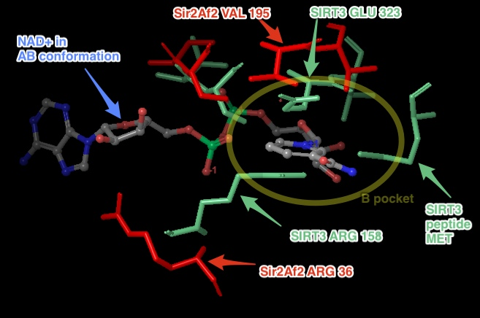
Comptitive vs. Non-competitive
NAD+ binding
 | MM-GBSA
 | AC | AB
Sir2 | -92.6 | -95.2 | ← Non-competitive
SIRT3 | -107.9 | -84.4 | ← Competitive
Steric clashes between NAD+ in the AB induced fit docked conformation into SIRT3 partially explain the less favorable energy
Cautious interpretation:
Numbers not absolute binding affinity
Difficult to obtain absolute binding affinity with NAD+
Not a cogeneric series
No co-crystallized structure of NAD+ in SIRT3
Notes:
Carefully explain limitations of the MM-GBSA numbers. Direct discussion to the figure, showing the how Sir2 has a more open volume in the B pocket, while SIRT3 does not. Question for me to answer: is the Sir2 crystal structure of NAD+ in AB and AC co-crystallized and the apo structures both support his more open conformation in the B pocket? Could this more open conformation in Sir2 be because the NAD+ AB co-crystallized structure conformed to that AB pose, while the structure available in SIRT3 does not have this accommodation?

Slide 16
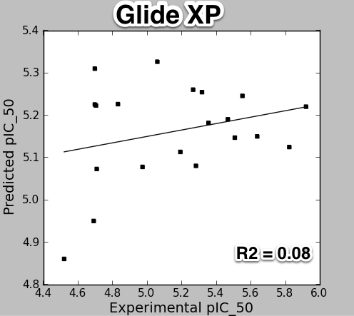
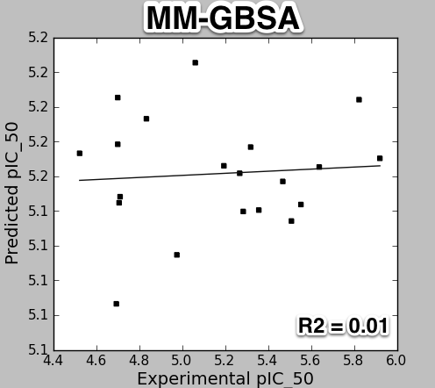
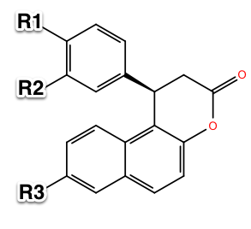
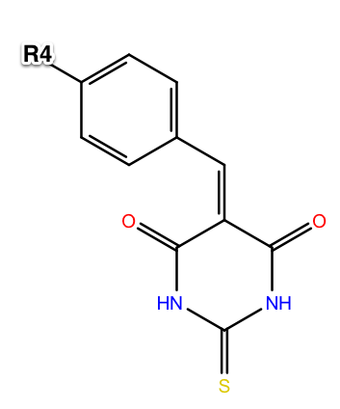
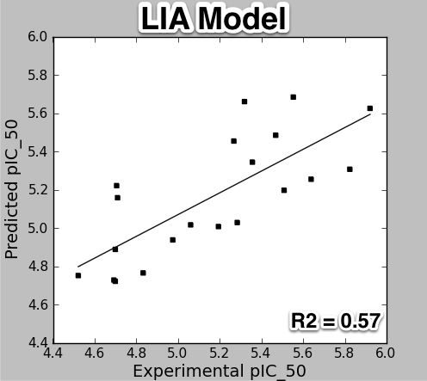
Binding Energy Prediction: SIRT2 Inhibitors
R = cyclopropyl, methyl, ethyl, propyl, bromo, fluoro, iodo, nitrile, etc
Uciechowska, Jung, Sippl, et.al. ChemMedChem 2008, 3, 1965.
Notes:
Chose SIRT2 as test case because good co-crystallized structures and experimental data available.
Following 4 figures of experimental ∆G_bind vs. computed, each a different method
Glide scores
MM-GBSA – standard, without induced fit or and without side chain or backbone optimization. Calculate MM-GBSA energy straight from GlideXP poses.
Induced Fit MM-GBSA – taking too long to run with limited number of licenses.
LIA from Liaison
Starting X-ray crystal structure:
1J8F, SIRT2; not a co-crystallized structure with an inhibitor – this is not available.
1J8F was starting structure for other papers, so I used the same.
3ZGV was a later structure available at beg. Of 2013 that has ADPR trapped intermediate. Possibly a better starting structure for simulations.
Ligands and experimental data from 2008 reference.

Slide 17
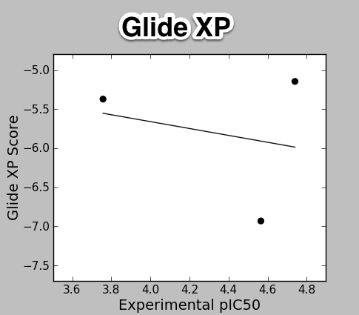
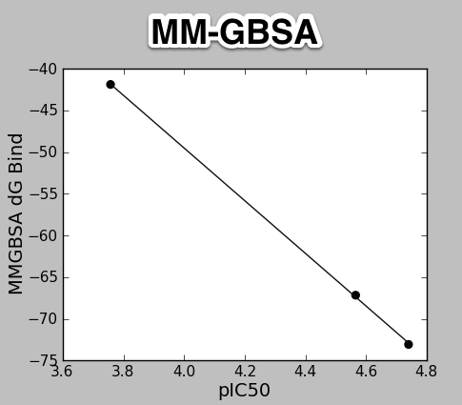
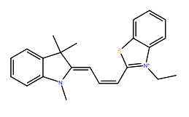
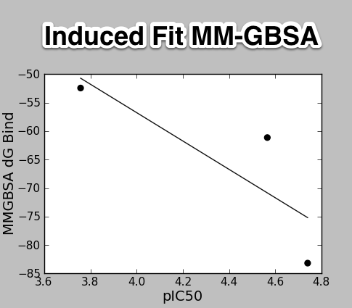
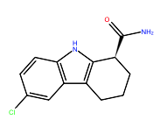
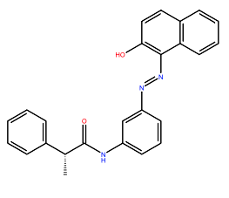
Binding Energy Prediction: SIRT3 Inhibitors
3 Tested High Affinity
Ligands: Ex-527,
Salermide, AC93253
Notes:
Following 4 figures of experimental ∆G_bind vs. computed, each a different method
Glide scores
MM-GBSA
Induced Fit MM-GBSA
LIA from Liaison – need more molecules……
Good correlation between MM-GBSA and experimental pIC50
to be determined if this correlation holds up with more molecules

Slide 18
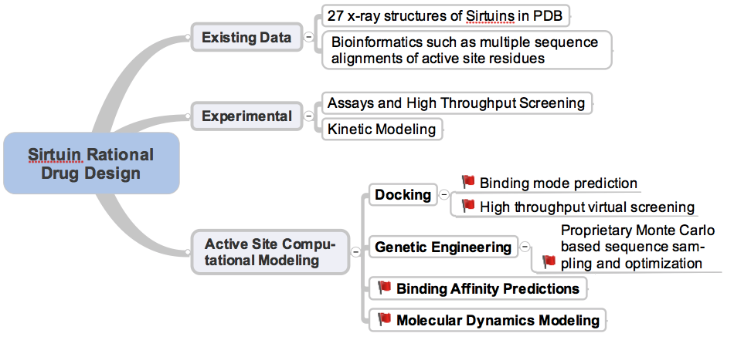
Future Direction
Base-Exchange assay
  Substrate specific
  Activators and inhibitors
Protein engineering
  Single mutation
  Site-directed mutagenesis
Structure study for binding affinity measurement
Simulation
Notes:
Cell-based deacetylation assay_ Milne JC, Lambert PD, Schenk S, et al. (2007) Nature 450:712-716.
FEP – free energy perturbation – N/A to screening large database

Slide 19
Acknowledgement
Dr. Clarence E. Schutt (Princeton University)
Dr. Irwin H. Segel (UC at Davis)

Slide 20
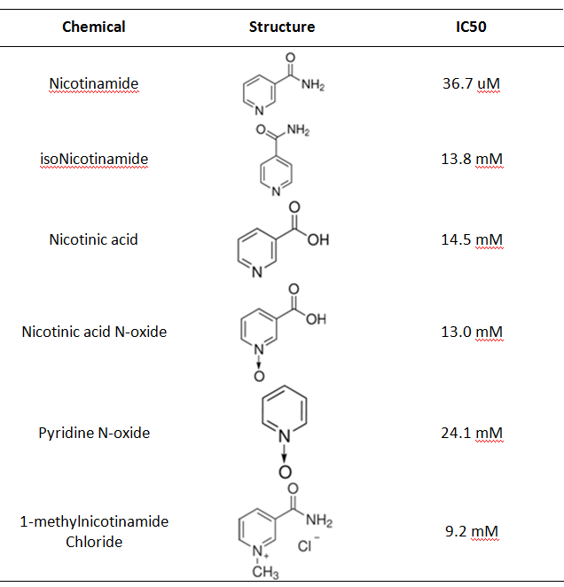
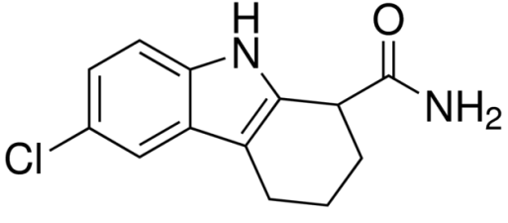
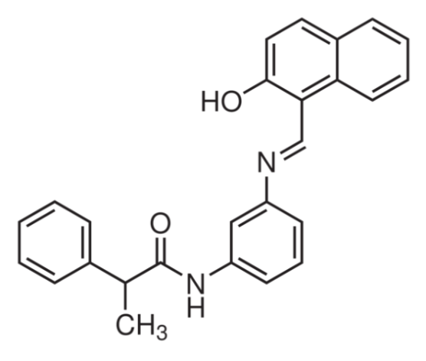
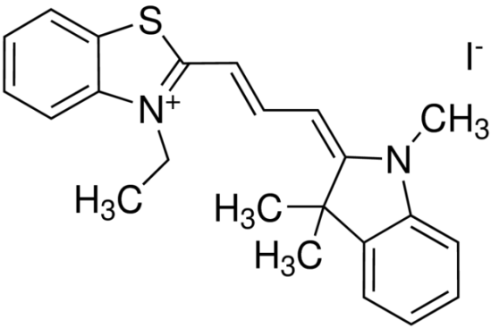
Potent hSIRT3 inhibitors
Ex-527 174.9 uM
Salermide 27.2 uM
AC93253 18.2 uM
Notes:
Strong inhibitors of hSIRT3 were found.

Slide 21

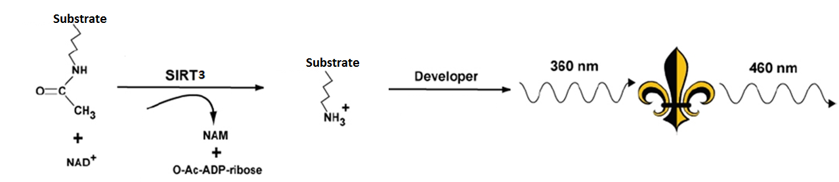
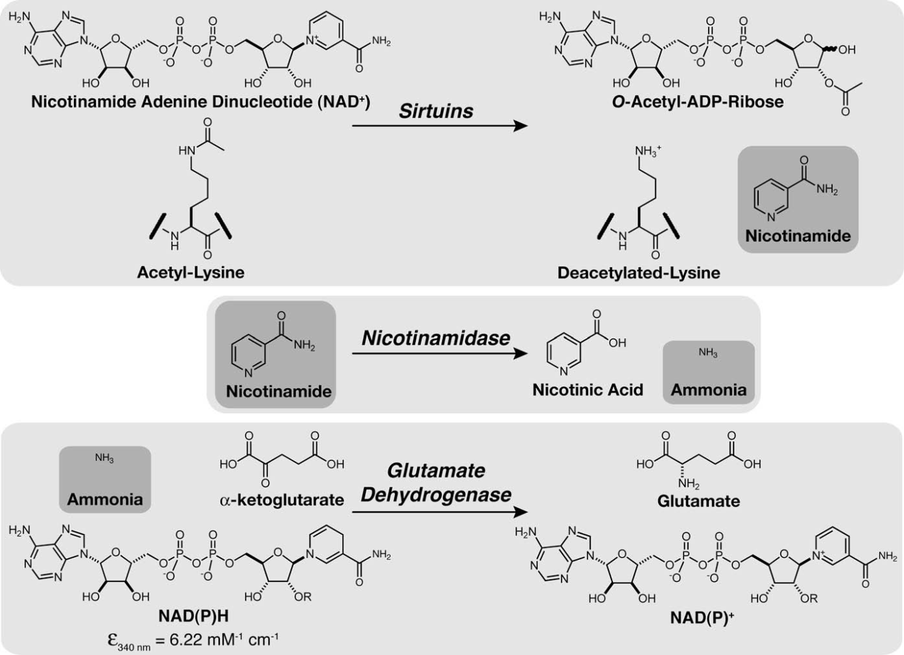
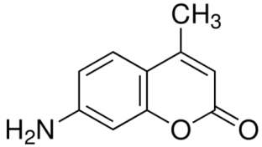
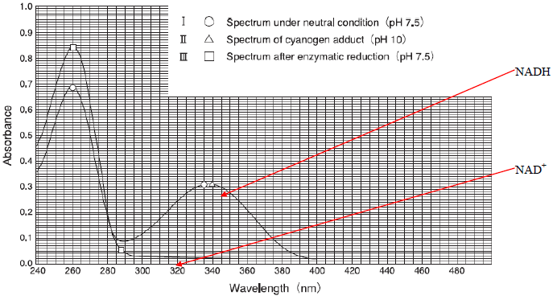
BIOMOL Assay
AMC
Notes:
The BIOMOL assay is a two steps fluorecsence-based assay. Firstly, the fluorescence labeled substrate with co-substrate NAD+ will be incubated with human SIRT3. Then Reaction was stopped by the addition of developer and 2mM NAM. The deacetylation-dependent fluorescent signal was developed (excitation wavelength = 360 nM and emission wavelength = 460 nM). The substrate peptide is acetylated p53, which is a native biological substrate. The Intensity of fluorescence was measured on a fluorometric microplate reader (Fluoroskan Ascent® FL, Thermo LabSystems) with excitation set at 355 nm and emission detection set at 460 nm. The initial rate of the NAD⁺-dependent deacetylation activity of SIRT3 enzyme was measured at different concentrations of nicotinamide adenine dinucleotide. The raw data were fitted to the Michaelis-Menten equation by using GraphPad Prism (GraphPad Software, Inc, CA) to obtain the kinetic constants.
The fluorophore is 7-amino-4-methylcoumarin (AMC).
The rate of nicotinamide formation is measured using a coupled enzyme system with nicotinamidase and glutamate dehydrogenase. Nicotinamidase hydrolyzes nicotinamide to nicotinic acid and ammonia. Glutamate dehydrogenase then converts ammonia, a-ketoglutarate, and NAD(P)H to glutamate and NAD(P)+. At 340nM, NAD(P)H has strong absorbance, but NAD does not. Therefore, the readout will be the intensity of NADH absorbance.
This is a continuous assay, unlike end-point assay, the spectrophotometer will record the decrease of intensity of NADH vs. time. The overall kinetic event will be monitored.

Slide 22
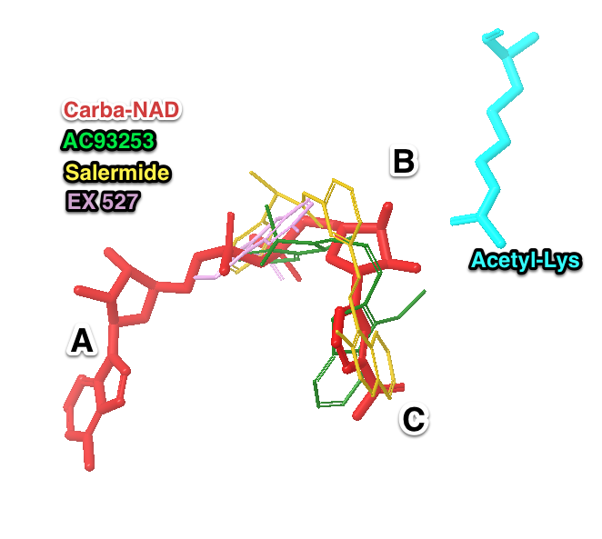
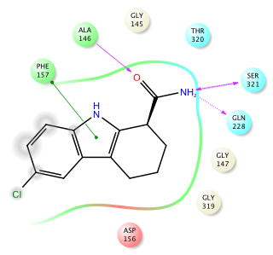


SIRT3 Inhibitors: Docking into 4FVT
EX527
AC93253
Salermide
Notes:
Analysis of the binding poses for the uM potent SIRT3 inhibitors:
They bind in part of the A and the C pockets, not the B pocket.
The most potent inhibitor, AC93253, does not have any H-bond contacts, it makes energetically favorable hydrophobic contacts
The other two, salermide and EX527 make different H-bond contacts.
The red ligand is the co-crystallized Carba-NAD from the 4FVT structure.
In ligand interaction diagrams: green is hydrophobic, red arrows are H-bonds.

Slide 23



SIRT3 Loops and Residues
Structural variation in flexible loop.
Highly conserved region.
SIRT3 4FVT
Residues near the A, B, and C binding
sites for NAD
Red: Non-conserved residues
Blue: Functionally conserved
No sidechain shown: completely conserved
SIRT3: 4FVT
Sir2: 2H4F
SIRT1: 4I5I
SIRT2: 3ZGV
SIRT5: 4G1C
SIRT6: 3PKI
Notes:
SIRT3 is from PDB 4FVT, which is co-crystallized with Carba-NAD+
Shown zoom of binding pocket A, B, and C in the Sirtuin.
This slide highlights the main differences between SIRT3 and SIRT1.
SIRT1: 4I5I; NAD in AB pocket, EX527 inhibitor in C pocket
SIRT2: 3ZGV; ADPR in AB pockets
SIRT3: 4FVT; Carba-NAD in AC pocket, with acetyl-lysine
Sir2: 2H4F; NAD+ in AC pocket with Acetyl-Lysine

Slide 24

Active Site: A, B, C pockets
ZOOM
Sir2
Notes:
Space-filling model of Sir2-Af2 and nicotinamide inhibition. Nicotinamide (NAM) in green is shown bound in the “C-pocket” of Sir2-Af2 adjacent to an NAD+ molecule in the active site. Inhibition by NAM is proposed to occur when free NAM binds in the C-pocket and reacts with the relatively long-lived peptidyl intermediate, driving the reaction in reverse to generate NAD+ and acetylated target protein (image provided courtesy of C. Wolberger, Johns Hopkins Medical School).

Slide 25

Loop Minimization
Do not need because of new SIRT3 crystal structure with Carba-NAD in AC pocket has loop closed in proper formation near C pocket.
Notes:
Note the missing residues from the loop in the SIRT3 with ADPR. In the new SIRT3 Carba-NAD, the loop is in the proper orientation.
Work from Wolberger’s group (see below 2005 reference) has shown that the flexible loop in Sir2 is influenced by NAD+ binding, which can trigger the assembly and disassembly of the C pocket. For example, the structure of Sir2Af2 bound to NAM has ordered flexible loop, but the structure of Sir2Tm bound to NAM has a partially disordered flexible loop from Arg34- to Ser44. In the above figure, the flexible loop in SIRT3 cocyrstallized with ADPR is disordered (broken brown line). The ADPR, which does not have atoms in the C pocket, does not make as many contacts with the flexible loop as the Carba-NAD structure. The full flexible loop is ordered (defined backbone trace in blue) in the SIRT3 with the Carba-NAD in the productive AC pockets.
Avalos, J.L., Bever, K.M., and Wolberger, C. (2005). Mechanism of Sirtuin Inhibition by Nicotinamide: Altering the NAD+ Cosubstrate Specificity of a Sir2 Enzyme. Molecular Cell 17, 855-868.

Slide 26

Structure and alignment of sirtuins
Verdin E, Hirschey MD, Finley LWS, Haigis MC. Review Trends in Biochemical Sciences Vol.35 No 671
Notes:
What cause the difference? SIRT1 and SIRT3 are Silent Information Regulator (Sir2) homologues. Sequence alignments indicate that the highly conserved residues, conserved residues, and residues involved NAM binding pocket in yeast Sir2 and human SIRT1 have 90% of similarity. On the contract, major structural differences were observed in residues in B, C pockets and loop area of yeast Sir2 and human SIRT3.
Simulation results have supported experimental data.
---------------------------------------------------------------------------------
Three-dimensional structures of the sirtuin core domains from yeast Sir2 (pdb: 2hjh), mammalian SIRT2 , SIRT3 and SIRT5 were generated using UCSF Chimera. In each structure, the catalytic histidine residue is highlighted in pink, and the N and C termini are shown in navy. Reference sequences for yeast Sir2 and mammalian SIRT1-5 were aligned by ClustalW and the region surrounding the catalytic core is shown with highly conserved amino acid residues shaded in blue and the catalytic histidine residue boxed in pink.

Slide 27

The contentious history of Sirtuin Debates
2013 Common mechanism of SIRT1 regulation by Allosteric activators
2010 STACs interact directly with SIRT1 and activate deacetylation by an allosteric mechanism.
2010 The presence of TAMRA label is necessary for activation SIRT1 by resveratrol along with SRT1460,
SRT1720, and SRT2183.
2007 Samll molecule activators, like resveratrol, can activate the SIRT1-catalyzed deacetylation as therapeutics for treatemtn of type 2 diabetes
Milne JC, Lambert PD, Schenk S, et al. (2007) Nature 450:712-716.
Pacholec M, Bleasdale JE, et al. J Bio Chem (2010) 285: 8340-8351.
Dai H, Kustigian L, et al J Bio Chem. (2010)285: 32695 – 32703.
Hubbard BP, Gomes AP, et al Science (2013) 339: 1216-1219.

Slide 28

NAD+, NAM, isoNAM
NAD+
Nicotinamide adenine dinucleotide is a coenzyme found in all living cells
NAM
isoNAM
Notes:
A NAM analogue, isonicotinamide (isoNAM), that competes for free NAM binding but does not react appreciably with the enzyme intermediate, in
creases the Sir2 activity
IsoNAM does not compete with NAD+ or acetyl lysine binding to hSIRT3, and it does not react with the imidate. However, isoNAM competitively inhibit NAM-exchange reaction thereby activates hSIRT3 activity by reliefing NAM inhibition. The compound isoNAM is a weak binding to hSIRT3 and only derepresses NAM inhibition at millimolar concentrations. The effect of isoNAM on yeast Sir2 has been reported to enhance gene silencing and correct for deletion of PNC1(56). IsoNAM is relatively non-toxic to mammalian cells, readily penetrates cells, very stable, and highly soluble in water, which make it a suitable starting compound to study with for design of sirtuin activator

Slide 29

Dittenhafer-Reed KE, Feldman JL, and Denu JM. (2011) ChemBioChem 12, 281-289.
Jackson M, Denu J. (2002) J Biol Chem. 277, 18535.
Borra M, Langer M, Slama J. (2004) Biochemistry 43, 9877.

Slide 30


Mechanism of Sirtuin deacetylation
Sauve AA, Youn DY. Current Opinion in Chemical Biology (2012) 16, 535-543.
Avalos JL, Boeke JD, Wolberger C. Mol. Cell (2004) 13: 639-648.
Notes:
Mechanisms of reaction of NAD+ with acetyllysine nucleophile. Three mechanistic possibilities can be considered for reaction of acetyllysine with NAD+, as shown by (SN1) and asynchronous SN2 reaction pathways. The SN1 mechanism proceeds through a discrete intermediate and the transition state for intermediate formation is not shown in this case. The transition states for the asynchronous SN2 mechanism is represented by chemical structures shown in brackets. Partial charges on groups at the transition state are shown by d+ symbols to qualitatively indicate group (group: nicotinamide, ribose and amide) charges determined by computational studies.
(D1) His118, acting as a base, activates the 2OH for internal attack on the destabilizing charge, which cleaves theO-alkylamidate.
(D2) The product of this attack is a cyclic amino-acetal that needs to be protonated to proceed with the reaction in two possible mechanisms:
SN1 or SN2. (D3-SN1) The amino group leaves the intermediate, thereby cleaving the amide bond and producing a cyclic acyl-oxonium ion.
(D4-SN1) The lysine is protonated and the acyl-oxonium is hydrolized to produce 2O-acetyl-ADP-ribose. (D3-SN2) Water attacks the aminoacetal
intermediate to produce deacetylated lysine and a cyclic orthoester. (D4-SN2) In an acid-catalyzed reaction, the cyclic orthoester is
hydrolyzed to produce 2O-acetyl-ADP-ribose. (D5) The positive charge in the lysine lacking other covalent bonds causes the Aly binding
hydrophobic tunnel to open. (D6) As the Aly binding tunnel opens, the enzyme releases the deacetylated peptide.
-------------------------------------
The initial chemical step of the sirtuin reaction involves nucleophilic addition of the acetyl oxygen to C1 of the nicotinamide ribose, forming a C1-O-alkylamidate intermediate. The mechanism of nucleophilic attack has been subject to discussion, with SN1, concerted SN2, and dissociative
SN2-like mechanisms proposed. A detailed study using kinetic isotope effects and computational approaches suggested that the first step of the reaction proceeds via a concerted yet highly asynchronous substitution mechanism. Several biochemical studies support the formation of the alkylamidate intermediate. These include nicotinamide base-exchange reactions and 18Olabeling studies that provide evidence for the direct transfer of the acetyl oxygen to the 1-hydroxyl of OAADPr. Utilization of acetyllysine analogs further demonstrated the existence of the alkylamidate intermediate. Thioacetyllysine- and acetylazalysinecontaining peptides form stalled alkylamidate intermediates when used as sirtuin substrates. Upon formation of the alkylamidate intermediate, the 2-hydroxyl group of the NAD ribose is activated by a conserved active-site histidine. The activated hydroxyl attacks the O-alkylamidate carbon to afford a 1,2-cyclic intermediate. Recently, the bicyclic intermediate was trapped and structurally resolved by incubating co-crystals of SIRT5 and an H3K9 thiosuccinyl-peptide with NAD, providing direct evidence for the proposed catalytic mechanism. A base-activated
water molecule then attacks the cyclic intermediate, affording deacetylated lysine and OAADPr Although deacylation is thought to be the primary function of human sirtuins, yeast Sir2 was first implicated as having the capability to transfer ADP-ribose from NAD to nucleophilic amino acids on protein substrates. SIRT4 and SIRT6 have also been reported to catalyze ADP-ribosyl transfer to glutamate dehydrogenase and poly(ADP-ribose) polymerase 1, respectively. This activity is not robust and has been subject to debate. Detailed kinetic characterization of the ADPribosyltransferase
activity of a yeast and bacterial sirtuin indicated that ADP-ribosylation may be a low efficiency side reaction (0.1% of the deacetylation reaction) of sirtuins due to the susceptibility of active site-bound ADP-ribose to nucleophilic attack. Understanding the mechanistic details of sirtuincatalyzed
reactions is an important step toward a complete understanding of sirtuin function and in the development of chemical tools to probe their biology.

Slide 31

Mechanism of activation of hSIRT3 deacetylation by isoNAM
Notes:
Isonicotinamide can compete with nicotinamide for binding but cannot initiate the reverse reaction, thereby leading to apparent activation through relief of nicotinamide inhibition (14, 58). Similar findings were observed in current study. The addition of 900uM isonicotinamide decreases the hSIRT3 inhibition by 20% in the presence of 100uM NAM. Structural and further biochemical studies on these compounds and mechanisms might enable the development of isoform selective modulators. Combining computational docking results, a proposed mechanism of activation of hSIRT3 deacetylation by isoNAM is described. IsoNAM has minor inhibition effect of hSIRT3 with IC50 = 13.8 mM. IsoNAM does not compete with NAD+ or acetyl lysine binding to hSIRT3, and it does not react with the imidate. However, isoNAM competitively inhibit NAM-exchange reaction thereby activates hSIRT3 activity by reliefing NAM inhibition. The compound isoNAM is a weak binding to hSIRT3 and only derepresses NAM inhibition at millimolar concentrations. The effect of isoNAM on yeast Sir2 has been reported to enhance gene silencing and correct for deletion of PNC1(56). IsoNAM is relatively non-toxic to mammalian cells, readily penetrates cells, very stable, and highly soluble in water, which make it a suitable starting compound to study with for design of sirtuin activator.

Slide 32


NAD⁺ nonproductive/productive conformations
Avalos JL, Bever KM, Wolberger C (2005) Molecular Cell, 17, 859-868.
Denu, J.M. (2003). Trends Biochem. Sci. 28, 41–48.
Notes:
NAD+ can bind in various “nonproductive” conformations that are not suitable for catalysis. However, simultaneous binding of NAD+ and substrate peptide to the enzyme promotes binding of NAD+ in a distinct “productive” conformation that places the nicotinamide ring in a highly conserved pocket, called the C porcket, where it is activated for catalysis.
In the absence of substrate peptide, NAD⁺ can bind in the A and B pockets of sirtuins in alternative nonporductive conformations
In the presence of substrate peptide, NAD⁺ binds in a precise productive conformation that buries its nicotinamide moiety in the highly conserved C pocket of sirtuins.

Slide 33

Within the C Pocket
Jackson, M.D et al J. Biol. Chem. (2003) 278, 50985–50998.
Sauve, A.A., and Schramm, V.L. Curr. Med. Chem. (2004)11, 807–826.
Notes:
Step i: NAD+ binds in a productive conformation in the C pocket (yellow), making hydrogen bonds with the rigid wall of the pocket (red residues), which promotes NAD+ cleavage (blue arrows). Step ii: The produced O-alkyl amidate intermediate in the extended confor-mation can reform NAD+ with a reactive nicotinamide in the C pocket unless the nicotinamide is entrapped by flipping (pink arrows) or the inter-mediate shifts to a contracted conformation (green arrows). Step iii: The entrapped nicotinamide buries its N1 against residues in the flexible wall of the C pocket (green residues), thereby preventing it from reacting with the O-alky amidate, even if this intermediate is in the extended conformation. From this position, nicotinamide can either flip out of entrapment (pink arrows) or be released by the enzyme (black arrows).

Slide 34

Physiological concentration of nicotinamide in Mammalian tissues
Animal | tissue | [nicotinamide] | Reference | Note
Sheep | Cerebrospinal fluid | 54.2 uM | Anal. Biochem (2002) 301: 21-26. | The entire surface of central nervous system is bathed by a clear, colorless fluid called cerebrospinal fluid (CSF). The CSF is contained within a system of fluid-filled cavities called ventricles. The ventricles are shown in blue on the following midsagittal section of the brain.
Rat | Liver | 26.2 uM 1.6umol/kg | J Bio Chem (1968) 243: 4980-4986.
 | Kidney | 1.0 umol/kg | Science (2004) 305:1010-1013.
 | Brain | 0.4 umol/kg
Mouse | Liver | 10 uM | Am J Clin Nutr (1971) 24: 800-804.

Slide 35



Flexible loop is influenced by NAD+ binding, which can trigger the assembly /disassembly of the C pocket
Sir2Af2 bound to nicotinamide (yellow) and nonproductive NAD⁺ (white) with a highlighted flexible loop (orange).
Sir2Af2 bound to nicotinamide (yellow) and ADP ribose (white) with a highlighted flexible loop (orange).
Sir2Tm bound to nicotinamide (yellow) and acetylated p53 peptide (blue), flexible loop highlighted (orange).
Avalos JL et al (2005) Mol Cell 17: 855-868.
Notes:
Sirtuins contain a highly flexible region, called the flexible loop, which adopts a variety of conformations in different crystal structures and is in some cases partially disordered. This 15-30 amino acid flexible loop includes some of the most highly conserved residues in sirtuins, which form the front wall of the C pocket. Nicotinamide can bind to sirtuins simultaneously with peptide, ADP ribose, or NAD⁺ that is in a nonproductive conformation. These ternary structures show that nicotinamide can bind I a collection of alternative positions that are anchored by the carboxamide group but leave that pyridine ring free to pivot inside the C pocket.

Slide 36










 | Competitive inhibition | Non-competitive inhibition
Equilibria
General Principle | In the presence of competitive inhibitor, the V_{max} remains unchanged but the apparent K_{m} for the substrate increased. Increase in the K_{m} does not mean that the EI complex has a lower affinity for the substrate. The EI has no affinity at all for the S, while affinity for E is unchanged. The apparent increase in the K_{m} results from a distribution of available enzyme between the “full affinity” and “no affinity” forms. | In the presence of noncompetitive inhibitor, the V_{max}, decreases but has no effect on the K_{m} value. The degree of inhibition in the presence of a non-competitive inhibitor depends only upon [I] and K_{i}. The inhibited velocity (vi) is always a constant fraction of v₀, regardless of the substrate concentration or the value of K_{m}. An increase in [S] causes both v₀ and vi to increase by the same factor.
Equations
v vs. [S]
1/v vs. 1/[S]

Slide 37

Sequence Alignment
Example of sequence alignment showing which residues are a part of the flexible loop (will highlight orange), which contact NAM (will highlight yellow), which are conserved (green) and highly conserved residues (red). The above is from the paper “Crystal Structures of Human SIRT3 Displaying Substrate-induced Conformational Changes” It will take some time to taylor the figure for our presentation. Want to make sure this is what we want before I do it.
Notes:
Sirtuins contain a highly flexible region, called the flexible loop. This 15-30 amino acid flexible loop includes some of the most highly conserved residues in sirtuins, which form the front wall of the C pocket. The C pocket is a largely hydrophobic cavity that contains the most highly conserved residues in the catalytic core of sirtuins.

